Slide 1
Eating, Drinking, Celebrating, and Fasting
Module 3

Slide 2
Learning objectives:
By the end of this session learners will:
Know the main basic information about food traditions in different cultures.
Have awareness of the connections between these traditions and religion.
Have an increased understanding of some traditions and why they can be important for your clients /patients.
Understand that the focus in care is always on the individual, no matter which cultural or religious background a person has.
Have practical insights on how to support clients in practising their religious/cultural traditions or rituals.

Slide 3
Introduction
When it comes to a hospital stay or a stay in a health resort - or even when it comes to moving to a retirement home - there are many questions about food that concern Muslims.
For example, I know people who take whole suitcases of food or cool bags with them [when they have to go to hospital or to a health resort] because they fear that they cannot or do not want to eat the food there. But this doesn't just affect Muslims...it also affects people of Jewish origin. There are many parallels between kosher and halal food preparation. The most common is the rule concerning pork, but there are also numerous religious subgroups - and they all have their own rules for dealing with it.
It is difficult for conservative, strictly devout Muslims, because there are also rules regarding food preparation - pots, cutlery, glasses must not have come into contact with forbidden food. About 20 years ago, I organised an Iftar meal for 300 women in a community centre. The food was supplied by a Turkish restaurant. We had borrowed the glasses from the neighbouring Chinese restaurant. Well, that was a problem! The women didn't want to drink from these glasses! It could have been that wine was once served in them. So I ran to the supermarket and got plastic cups. I [note: Muslim myself] was not prepared for that either.
.... When staying in hospital, there is little choice for Muslim patients when it comes to food. As a result, many have their food brought by relatives. I don't know if the hospital staff are always very happy about this. Or sometimes it might bother the other patients in the room - because of the smell...I have the feeling that more could be done in hospitals to accommodate such groups of people who eat halal or kosher food....
Social worker, Vienna, Austria
What do you think? Have you experienced such a situation with your patients/clients? Or anything similar?

Slide 4
DIETARY rules AND THE MEANING OF FASTING in the world religions
PATIENT RELATED FACTORS

Slide 5
Eating, drinking, celebrating, fasting
Eating, drinking, celebrating, fasting - these issues strongly influence the daily life of people and in this way these issues have to be taken into consideration when it comes to health/social care of people;
Nutrition and eating habits can be cultural, traditional or religious;
People from other countries of origin may reject certain food because they are not familiar with it;
Often however, religious traditions are also closely linked to dietary habits and commandments.

Slide 6
Exercise: Think about these questions:
Knowledge about traditions and religious rituals can not be used like a recipe. But it can help to have an increased understanding of the needs of patients, especially when working with older people:
How can we meet certain nutritional needs in care situations?
How can we react in situations, when these habits or rules can not be followed due to medical indications and for treatment reasons?
How should we act?
How should we explain it to the patient?
How do we explain it to the family to get them on board?
?

Slide 7
Nutrition in connection with religion
There are dietary rules in every religion.
They apply to everyday life and to feast days and fasting periods, and in some religions also to the way food is prepared.
Some rules are for respecting animals. Others are meant to commemorate an event or a person, to promote health, to encourage reflection, or to train self-control.
Some religions have their own words for permitted foods and other things. Muslims, for example, prefer to eat halal and Jews kosher.

Slide 8
1. Islam
For devout Muslims, some foods are forbidden. These include, for example, pork and meat (including beef) from dead animals that have not died naturally or by being slaughtered in a certain way. This must be done by throat cutting. If these animals are slaughtered in this way, it is called “halal” = allowed. The prohibitions also include the blood and animal products from pigs, such as lard, fat or gelatin. These may be found in food such as some types of cheese and in some sweets. Alcohol is also banned.
In order to provide a diet that complies with the Islamic dietary requirements, possible animal additives should listed in menus.
However, religious principles can be suspended in the case of emergency and when no alternatives are available. This includes, for example, taking otherwise prohibited products such as medicines containing alcohol, or not performing religious duties such as fasting during Ramadan.

Slide 9
2. Kashrut - Judaism
Two basic rules:
Meat and other animal components must come from "permitted" animals.
2. Dairy and meat are separated.
Jews must never eat some foods and must not combine others together. This applies especially to meat and milk, and anything made from them. Other foods are forbidden at certain times. The methods of preparation is also important. Many foods and menus must be produced, processed and prepared in a special way. There are also rules for the storage of supplies and for the handling of dishes.
Kosher - what is pure and suitable?
They may be prepared with milk, cream, cheese or other dairy products.

Slide 10
3. Hinduism
For many Hindus, a meal is also an important part of their religious life. Depending on the denomination and stage of life, certain rules of eating apply:
Beef is taboo for Hindus, because cows are sacred animals in Hinduism.
Many Hindus are vegetarians and therefore do not eat any dish that contains meat or other ingredients from an animal, because Hindus believe in eternal rebirth. According to this belief, a person's soul can also be reborn in an animal. Therefore, many Hindus do not want to kill an animal.
Hindus wash their hands before every meal, because eating is a religious act for Hindus, and this always includes cleanliness. It is also about practical hygiene, because many Hindus eat without cutlery, with their right hand.

Slide 11
4. Buddhism
Buddhists have no uniform rules about what food they should and should not eat. Their main concern is not to waste food. Therefore, they should eat only when they are hungry and only enough to fill them up. In addition, it is forbidden to simply throw away or let food that is still edible go to waste.
A precept of Buddhism forbids inflicting suffering on animals. This includes not slaughtering an animal just to eat it. Therefore, many Buddhists are strictly vegetarian. Others, however, do not abstain completely from meat. What else is put on whose table depends above all on the individual religious community and the place of residence of a Buddhist.

Slide 12
5. Christianity
Generally speaking, there are no specific rules or restrictions for Christians regarding food and diet, although some denominations prohibit alcohol and others may have periods of fasting.

Slide 13

Find the matches
How much do you know about different diets, some of which are followed because of religious beliefs, others for medical reasons or through their own choice. Match up the terms in the box on the righthand side to the descriptions of diet.
Vegan Haram
Lactose intolerant
Fructose intolerant
Kashrut
Kosher
Halal
Ovo-lacto vegetarian
1. This means, meat is allowed if the animal has lived as species-appropriate as possible and has been slaughtered by throat cutting.
2. The name for the Jewish dietary law is….
3. Meat and other animal components must come from "permitted" animals. Dairy and meat are separated.
4. In addition to the purely plant-based diet, eggs and milk are also allowed
5. Any animal products are avoided in this diet
6. Dairy products/products with lactose must not be eaten
7. Fruit juices and dried fruits should be avoided in the long run. Likewise, anything sweetened with fructose or sorbitol.
8. Alcohol and pork for Muslims are…..

Slide 14

Answers
Halal
Kashrut
Kosher
Ovo-lacto vegetarian
Vegan
Lactose intolerant
Fructose intolerant
Haram
If you do not know some of these terms you can look them up.

Slide 15
The meaning of fasting
The practice of spiritual fasting builds focus and awareness. As such, the spiritual benefits of healthy fasting include a stronger sense of one’s connection with the universe. Spiritual fasting aims at making people feel less self-centered. It is a way to free oneself from the confines of what someone wants or thinks he/she needs.
This is the definition of fasting in the spiritual way.
Fasting is practiced in various religions in different ways and at different opportunities.
In combination with medical problems, religious fasting can have negative effects on the general condition of patients. Therefore, it is important for the medical and care staff to inform about the possible risks as a consequence of fasting.
In most religions, health takes precedence over the requirement to fast.

Slide 16
Fasting in different religions
Islam
Ramadan is the fasting month of the Muslims. For 30 days, they are not allowed to eat, drink or smoke between sunrise and sunset. Sexual intercourse is also prohibited. The breaking of the fast in the evening takes place in larger groups - so Ramadan has a strong family and community-building character.
Excluded from this duty are: The old, the sick, the weak, travelers, pregnant women, women who have recently given birth and menstruating women.
Judaism
In Judaism, there are various fasting periods. No one is allowed to completely abstain from food and drink for more than 25 hours at a time, because health comes first.
Yom Kippur is the great day of atonement and fasting in Judaism. On this day, people are not allowed to eat, drink or smoke. One does not wash, is sexually abstinent and does not go to work.
Orthodox Church
In the Orthodox Church there are four fasts of several weeks in the church year: seven weeks in Passiontide, the Apostles' Fast one week after Pentecost, the Koimesis Fast in August and the Advent Fast from mid-November to 24 December. In addition, fasting takes place on every Wednesday and Friday. Meat, eggs and dairy products are forbidden on all fast days, as well as fish, wine and oil on strict fast.
Hinduism
Many Hindus fast to atone for something and to purify the soul, to ask a blessing for someone or to honor a deity or to be close to it.
Who fasts when, for how long, and in what way is decided by each individual. Fixed fasting times or fasting rituals are not prescribed in Hinduism.
Buddhism
Buddhists do not have uniform fasting periods like other religions. They vary from one faith and country to another. Certain traditions, for example, Zen Buddhists believe eating little, however, facilitates meditation on the path to inner peace and enlightenment.
This is why Buddhist monks and nuns abstain from all food after noon every day. In addition, there are monthly fasting days.
Christianity
For Christians, Lent or Passion lasts from Ash Wednesday to Easter. During this time, people are supposed to reflect anew through abstinence, do penance and seek closeness to God.
Today, however, there are no longer strict rules. Everyone can decide for themselves how they want to organise Lent.

Slide 17
Practical tips for professionals
Every patient is an individual with his or her own history, personality and worldview. There is therefore no all-encompassing "checklist" for dealing with patients of different religions. But you can consider the following aspects when it comes to nutrition and dietary rules:
Dietary habits and special diets or food intolerances should be recorded in the medical history;
In order to enable a diet that complies with the nutritional requirements, possible (animal) additives should be stated on any menus;
Medication issues: e.g., Muslim patients may refuse medication that contains animal products (e.g. gelatin in capsules, heparin) or alcohol. In general, it should be pointed out in such cases that things that are forbidden per se are permitted for healing and therapy if there are no alternatives. If alternatives exist, they should be used;
Always try to involve the family and inform them in case of necessary nutrition or dietary issues;
In case of religious concerns, it can be helpful to involve the hospital chaplain, or another representative of the religious community concerned to solve the problem.

Slide 18

Self-reflection
Thinking about the context you are working in:
How can you find out about patient‘s needs regarding food traditions or rules?
What opportunities are there in your organisation to address these needs?
What do you need to better address the individual needs of patients/clients?

Slide 19
Summary
Eating habits are often, but not always, determined by religion. Whether someone is vegetarian or vegan, wants to eat halal or kosher - this is based on different views and world views.
In care, it is important to always emphasise the health aspect of nutrition, but to bring understanding for individual needs and also to create alternatives. Caregivers do not have to be experts in religious studies - but a basic knowledge of certain topics can be helpful.
Transcultural care should assess and respect people as individuals not because of their religion but because of their needs.

Slide 20
Celebrations in different cultures And Religions

Slide 21
Meaning of celebrations
Festivals are mostly a collective occasion and have meaning not only for the individual but also for the celebrating group as a whole.
Religious festivals in particular have a meaningful effect on the religious community.
Cultural celebrations and religious festivals are also often an important distraction from the worries and stresses of everyday life.
This gives festivals a special significance for sick and/or elderly people. Especially when they are not in their family or home environment, celebrating together can be an important emotional support.

Slide 22

Be a Cultural Expert for 1 day
Interview your partner/self-reflective activity -
Where do you/your colleagues come from?
What kind of celebrations do you/they have in their culture/traditions?
Does everyone practice them? How do they practice them?
Are there any opportunities for you/them to follow their traditions in the workplace?

Slide 23
Religious and cultural traditions in health care settings
Older people in particular can be increasingly reflective of their origins and traditions.
It is therefore important for them to live in an environment where this need is respected.
While religious traditions cannot always be taken into account in hospitals for medical reasons and due to the strict regimentation of everyday hospital life, the individual life situation of the patients should be better taken into account in old people's or nursing homes, since they live there permanently.

Slide 24
Nutrition habits and religious/cultural traditions in health-/social care settings - culturally sensitive care
“Culturally sensitive care contributes to a person in need of care being able to live according to their individual values, cultural and religious imprints and needs.”
According to this, culturally sensitive care means being receptive to each individual, their biography, their religious, cultural, gender-specific and/or migration-related backgrounds and their individual needs.
Ultimately, this also includes respecting certain food rules and allowing religious traditions and festivals to be celebrated.
The appreciation of the clients and their culture must be integrated into care activities

Slide 25
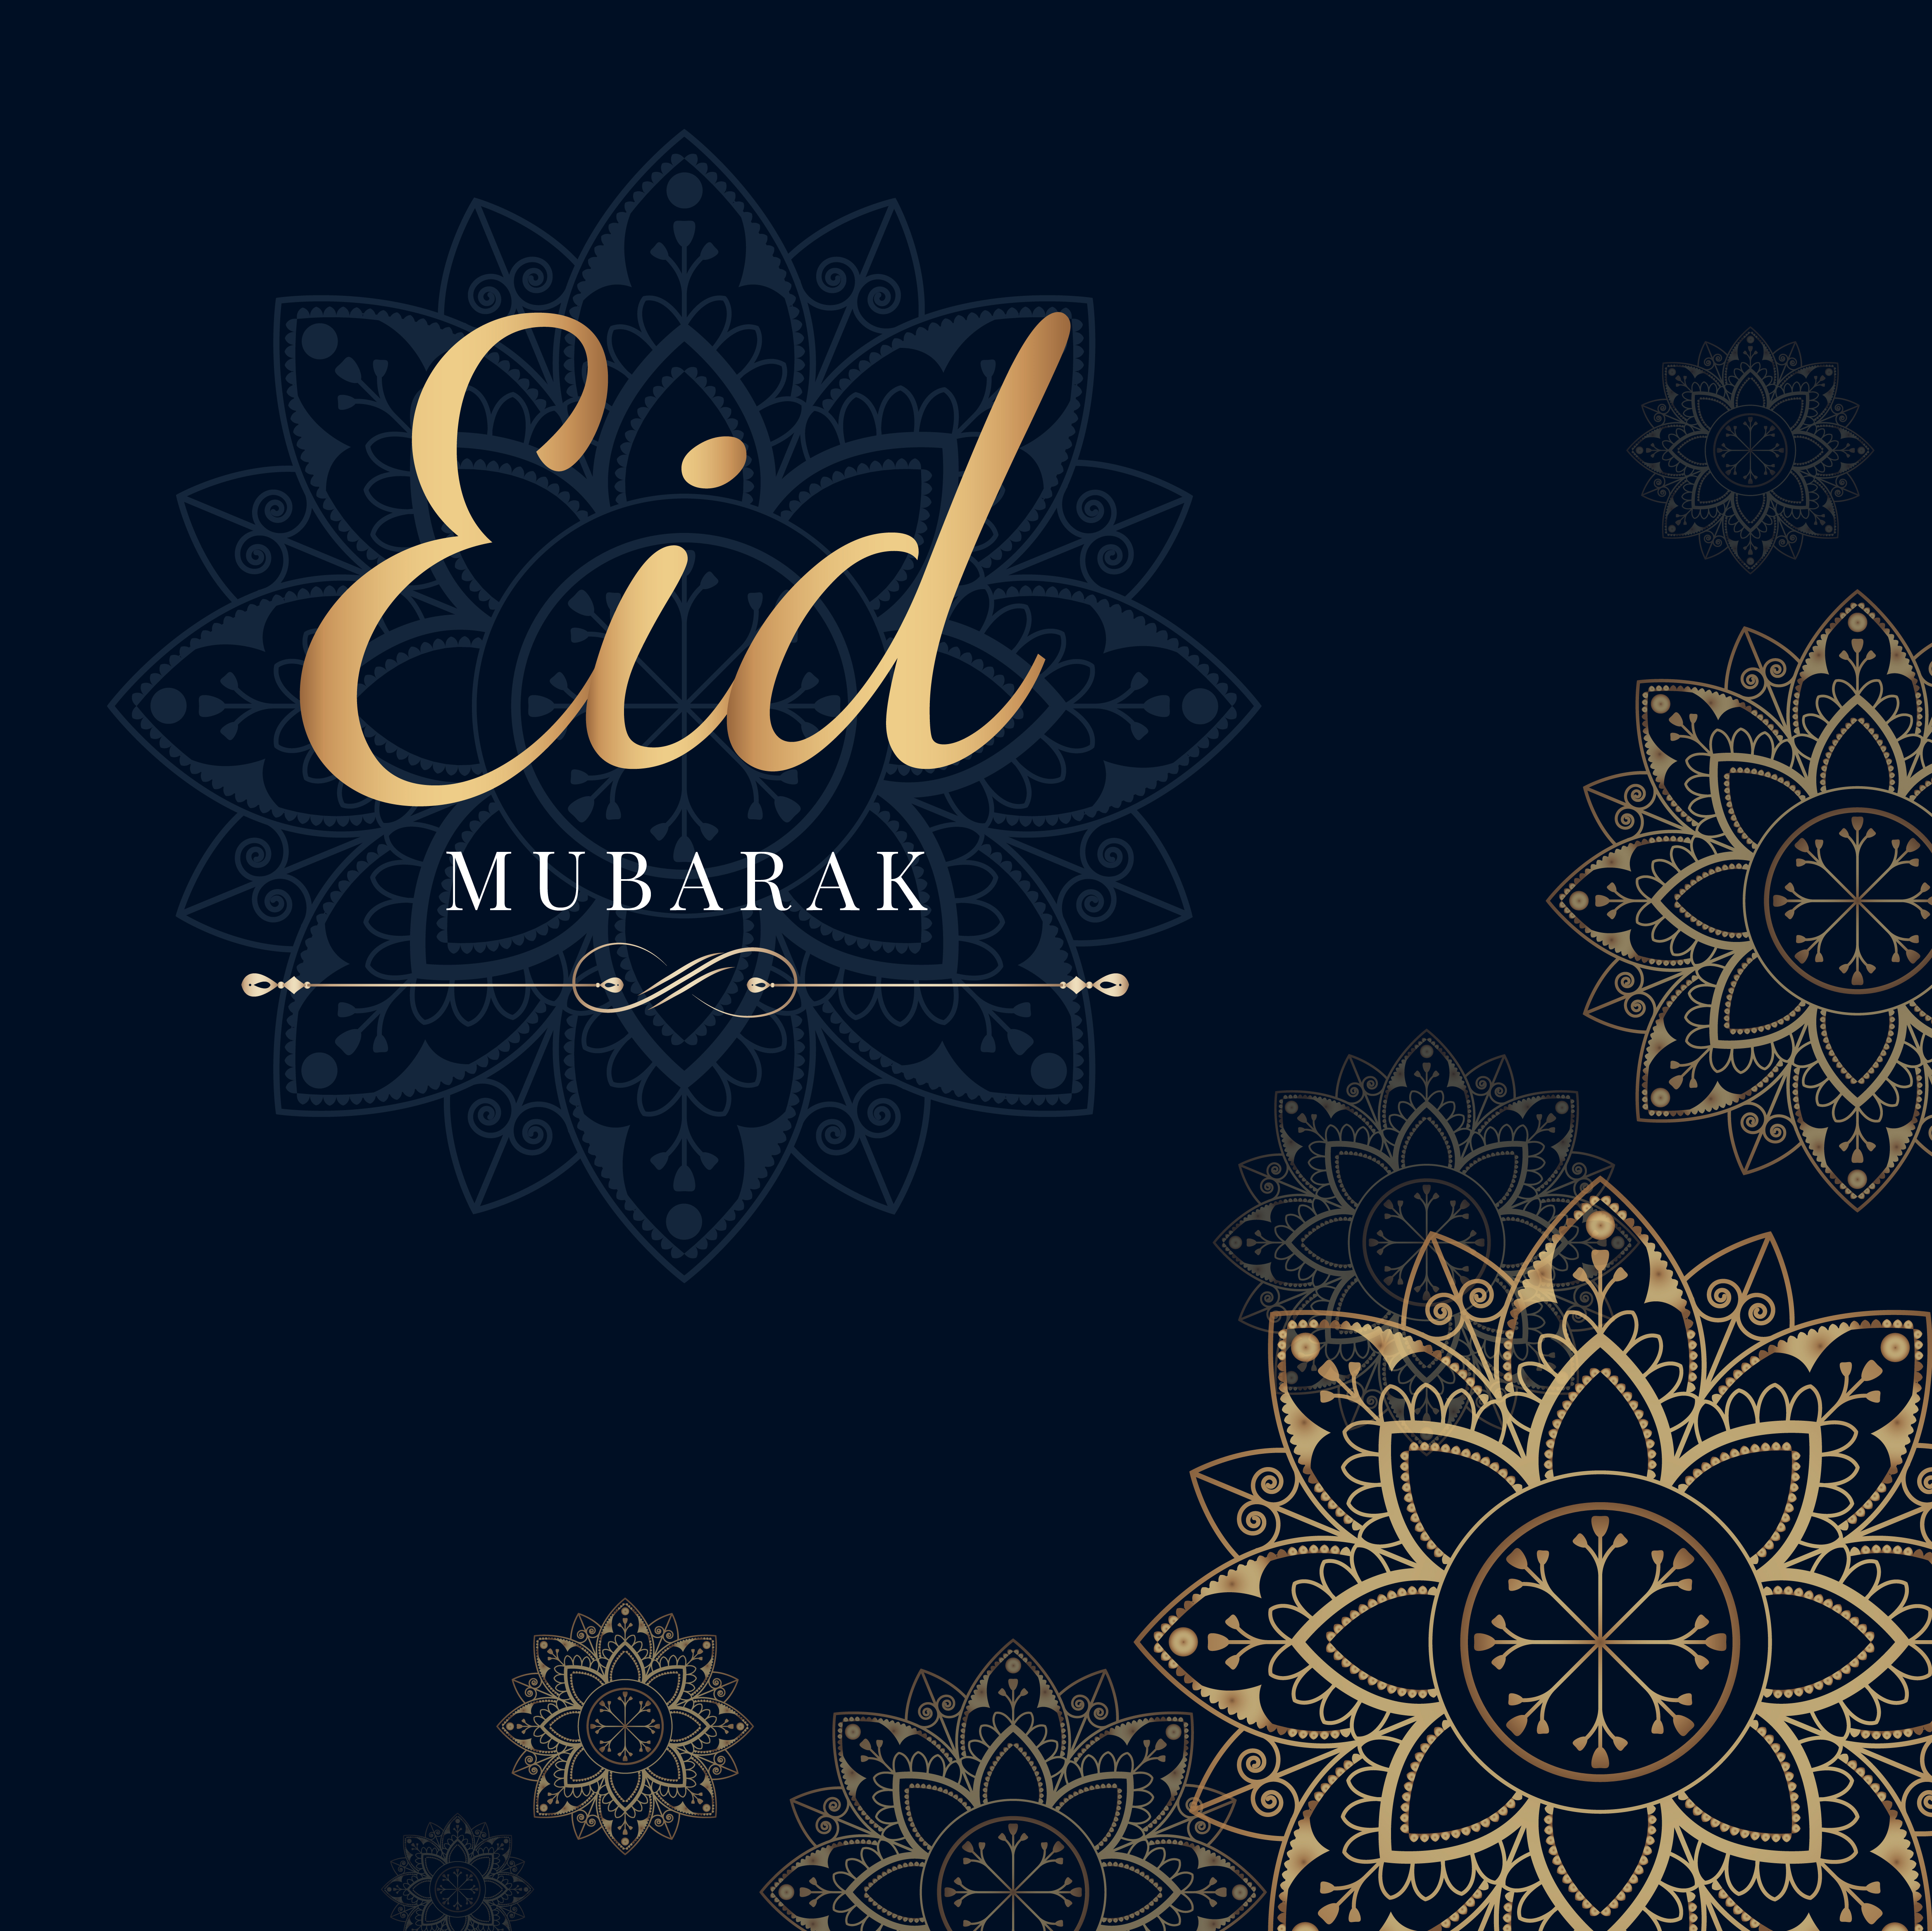
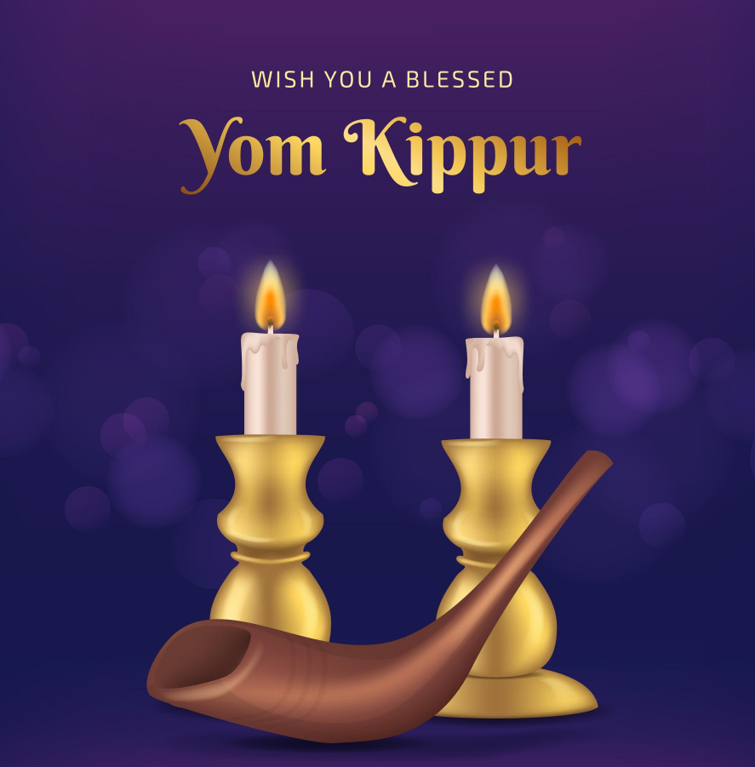
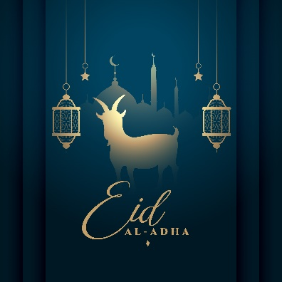
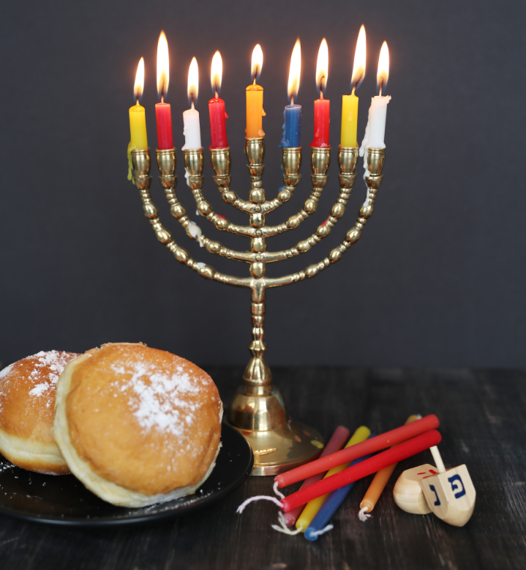
Celebrations in Islam & Judaism
Eid is often called the festival of breaking the fast. It ends the fasting in Ramadan. In Arabic it is called Id al-Fitr. There are differences in the type of celebration depending on the country and region. The festive season is used to visit relatives and friends. Sweet dishes are usually served and a lot of sweets are distributed and eaten.
The Feast of Sacrifice is the most important festival for Muslims. It reminds them that they should and can trust God. Chronologically it is celebrated after Ramadan.
Yom Kippur is the strictest holiday in Judaism. Yom Kippur is observed in a more or less strict form by a majority of Jews, even non-religious ones.
Hanukkah is the festival of lights. Hanukkah is primarily a domestic celebration. On Hanukkah evening, families gather with friends for boisterous celebrations. Community celebrations are common, and children receive gifts and sweets.
Vecteezy.com
Designed by Freepik
AP Photo/Amr Nabil
Designed by Freepik

Slide 26

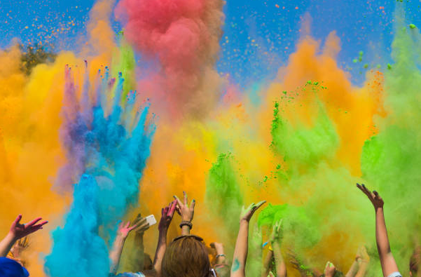
Celebrations in Buddhism & Hinduism
In Buddhism, the most important festival is called Vesakh, which Buddhists all over the world celebrate as a unifying holiday. Vesakh is the birthday celebration for the Buddha
Reuters/Dinuka Liyanaatte
canva.com
Festivals in Hinduism often have something to do with the seasons. Holi is a joyful festival where all participants throw coloured flour or powder at each other. Hindus use it to celebrate the beginning of spring.
https://pixabay.com/de/images/

Slide 27
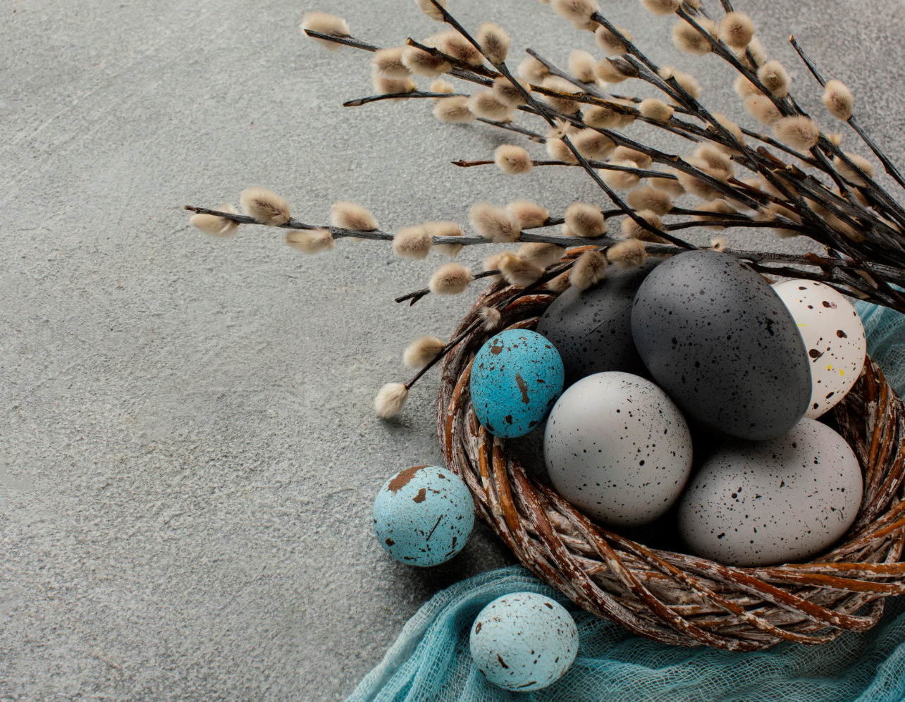

Celebrations in Christianity
Christians have around 20 feast days a year.
The main Christian festival is Easter - the commemoration of the event with which Christianity stands and falls, the resurrection of Jesus Christ.
This is followed by the feasts of Ascension and Pentecost.
Christmas - Christians celebrate Jesus' birthday. There are many other customs surrounding Christmas: a fir tree is put up in the house and decorated. Many families sing and pray, presents are given.

Slide 28
Did you know that….?.
The meaning of Diwali
Diwali is an important religious festival originating in India. People often think of Diwali as a Hindu festival, but it is also celebrated by Sikhs and Jains. Diwali takes place annually and lasts for five days, marking the start of the Hindu New Year. The exact dates change each year and are determined by the position of the moon – but it usually falls between October and November.
Easter baskets have special symbolism.
The woven containers represent nests and new life, especially when filled to the brim with eggs.
Hanukkah isn’t the Jewish Christmas
Because Hanukkah and Christmas tend to fall around the same time of year, people often wonder if Hanukkah is a Jewish version of Christmas. It is not, but similarities can be seen in the celebrations.
Chinese New Year, also called Spring Festival, is primarily a family holiday. Traditionally, people get together on New Year's Eve to eat together. Many people also use this time to go on holiday. The festivities traditionally last seven days, ending with the Lantern Festival.
The Islamic calendar is shorter than a western Gregorian calendar; there are just 354 days in a normal year, and 355 days in a leap year. The dates of the Islamic holidays change each year in relation to the solar calendar.
For Greek Orthodox, roasted lamb on a spit is the traditional dish of Easter Sunday. It is served like this because according to the Apostle John, Jesus is the Lamb of God. He died on the cross as a sacrifice for our sins. Eating lamb honors this.

Slide 29

What could happen…?
Consider the 2 questions. 1. How do traditional celebrations/feasts influence the daily routine in a hospital/care centre? Think about concrete incidents or situations like e.g. planning a surgery…
2. How can you as a caregiver create opportunities for different cultural celebrations to be celebrated in the hospital/nursing home?

Slide 30
Good practice example
ABEDL structure model
The ABEDL structure model maps the needs, abilities and resources of the person and serves as a recording and data allocation tool with which the individual care needs can be named. It was developed from the German care scientist Monika Krohwinkel.
Krohwinkel defines 13 ABEDLs (ABEDL = activities and existential experiences of life) which are interrelated but do not have a hierarchical structure. With this classification, the documentation of the care process is made possible, for example, the structured creation of a care anamnesis or care planning is facilitated.

Slide 31




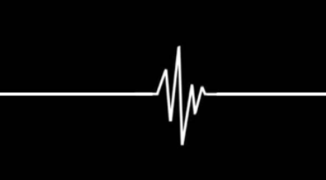




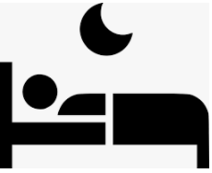


being able to deal with existential experiences of life
being able to communicate
being able to engage in a social life
being able to move
being able to provide safety in the environment
being able to maintain vital functions of the body
The ABEDL Modell
13 activities and
existential experiences of life
being able to feel like a man/woman
being able to care for oneself
being able to use the toilet independently
Being able to rest and sleep
being able to dress oneself
Being able to eat and drink
being able to occupy oneself

Slide 32
The model illustrates that care should allow for the preservation of human independence and well-being.
Care focuses on the individual life history and life situation as well as the person's support and ability.
This also includes the consideration of a person’s cultural background

Slide 33
Summary
Especially in the context of elderly care, it is important to take celebrations into consideration. The older people get, the more traditions can gain in importance again for them.
Working with people from different cultures also means respecting their different traditions and celebrations and valuing them.
According to this, culturally sensitive care means being receptive to each individual, their biography, their religious, cultural, gender-specific and/or migration-related backgrounds and their individual needs.

Slide 34
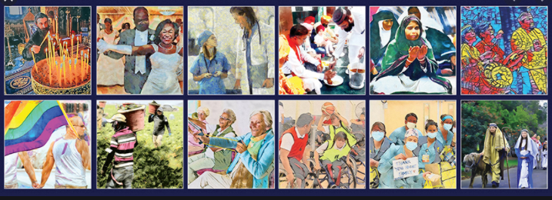
Intercultural timeplanner An intercultural timeplanner is a useful tool to have an overview on all holidays of different religions throughout the year
https://www.diversitybestpractices.com/2021-diversity-holidays
https://www.diversityresources.com/february-2021-diversity-calendar/
Source: https://www.usamulticulturalcalendar.com/Wall_Calender_a/256.htm

Slide 35
References
Gülal F., Kultursensible Pflege und Betreuung von muslimischen Menschen (Culturally sensitive care and support for muslim people), 2017 Heilbronn
religionen-entdecken.de; https://religionen-entdecken.de/lexikon/e/essen-in-den-religionen
Jana, M.: Auf dem Weg zu einer interkulturellen Altenpflege (On the way to intercultural care for the elderly), DIE, Bonn, 2004
Aru Narayanasamy: Transcultural nursing: How do nurses respond to cultural needs? British Journal of nursing, May 2002
doka-pflege.de
Leimgruber, W.: Warum feiern wir Feste (Why do we celebrate?), University Basel https://www.unibas.ch/de/Aktuell/Uni-Nova/Uni-Nova-115/Uni-Nova-115-Feste.html

Slide 36
References – images and pictures
Slide 24:
https://www.vecteezy.com/vector-art/2288908-eid-mubarak-islamic-festival-celebration-with-vector-illustration-on-blue-background
https://www.businessinsider.com/photos-muslims-celebrating-eid-al-fitr-2016-7#egypt-celebrations-often-pour-out-into-the-streets-muslims-in-cairo-waited-to-catch-the-hundreds-of-balloons-distributed-after-eid-al-fitr-prayers-4; AP Photo/Amr Nabil
https://de.freepik.com/
Slide 25:
https://pixabay.com/de/images
https://religion.orf.at/v3/lexikon/stories/2568989//, Reuters/Dinuka Liyanawatte
Slide 26:
https://de.freepik.com/
Slide 29:
https://www.usamulticulturalcalendar.com/Wall_Calender_a/256.htm

Slide 37
Further Reading
Alpers, L.-M.: Hospital food: When nurses' and ethnic minority patients' understanding of Islamic dietary needs differ; https://onlinelibrary.wiley.com/doi/full/10.1002/nop2.343
Dixon, B.: Cultural Traditons and Healthcare Beliefs of Some Older Adults https://www.virtualhospice.ca/Assets/cultural%20traditions%20and%20healthcare%20beliefs%20of%20older%20adults_20090429151038.pdf
Patience S.: Religion and dietary choices; https://www.independentnurse.co.uk/clinical-article/religion-and-dietary-choices/145719/
https://thrivemeetings.com/2018/01/religious-dietary-restrictions-guide/
http://what-when-how.com/nursing/transcultural-and-social-aspects-of-nutrition-nutrition-and-diet-therapy-nursing-part-3/
https://www.scholastic.com/teachers/articles/teaching-content/religious-commemorations-around-world/
https://en.wikipedia.org/wiki/Religious_festival

Slide 38


