Slide 1
DISABILITY, PSYCHOLOGY & mental Health problems
Module 7

Slide 2
What you will gain from this module:
Acquire basic knowledge of the interrelations between disability & culture and psychology/ mental health problems & culture.
Understand how the conceptual frameworks of disability & psychology/mental health are socially and culturally constructed.
Recognise your own biases and stereotyping patterns towards disability, mental health & different ethnocultural groups.
Be able to identify ways that intercultural competence can help professionals examine the sociocultural factors that influence the persons’ views.
Understand the power of inequalities in cross culture encounters.
Be more sensitive to cultural differences regarding disability & mental health, and different ways of responding in a variety of situations.

Slide 3
DISABILITY

Slide 4
Disability stories
‘My adventure started at the age of 12 when I was playing football and suddenly had a pain in my right leg! My parents and I went to do the necessary tests and I was diagnosed with osteosarcoma (bone cancer). It was something that terrified us all. Many rounds of surgery and cycles of chemotherapy followed with success. After 2 years however, the scan showed exactly the same problem. This time in a more aggressive form of cancer. So, all we could do was amputate it, so I could continue living my life. I am now 19 years old, studying Diet and Nutrition at Harokopio University in Athens and I am involved in cycling, representing Greece in competitions abroad.’
Nikos
‘My life is my two beautiful children. They see me as ‘Mummy’, not a person in a wheelchair and do not judge me or our life. This is now changing as my efforts to be part of their life is limited by the physical access of schools, parks and shops; the attitudes of other parents; and the reality of needing 8 hours support a day with my personal care… I cannot get into the houses of my children’s friends and must wait outside for them to finish playing. Other parents see me as different, and I have had one parent not want my son to play with her son because I could not help with supervision in her inaccessible house.’
Doris

Slide 5
Key facts on disability (WHO, 2020):
Over 1 billion people live with a form of disability, meaning 15% of global population or 1 in 7 people.
It is a global public health issue and a social rights issue.
The number of people with disabilities is increasing.
Everybody is likely to experience disability at some point in life.

Slide 6
The United Nations Convention on the Rights of Persons with Disabilities (CRPD)
Article 25 on Health:
People with disabilities have the right to the highest attainable standard of health without discrimination on the basis of disability. They are to receive the same range, quality and standard of free or affordable health services as provided other persons, receive those health services needed because of their disabilities, and not to be discriminated against in the provision of health insurance.
Article 27 on Employment/work:
People with disabilities have equal rights to work and gain a living. Countries are to prohibit discrimination in job-related matters, promote self-employment, entrepreneurship and starting one’s own business, employ persons with disabilities in the public sector, promote their employment in the private sector, and ensure that they are provided with reasonable accommodation at work.
CRPD (2006):
Aims to “promote, protect and ensure the full and equal enjoyment of all human rights and fundamental freedoms by all persons with disabilities, and to promote respect for their inherent dignity”.

Slide 7
International Classification of Functioning, Disability and Health (ICF)
Medical Model:
Disability as a feature of the person, directly caused by disease, trauma or other health condition, which requires medical care provided in the form of individual treatment by professionals. Medical or other treatment/ intervention to 'correct' the problem with the individual.
Social Model:
Disability as a socially created problem and not at all an attribute of an individual which demands a political response. Attitudes and other features of the social environment form an unaccommodating physical environment which create the problem.
There are 2 major conceptual models on disability based on WHO's International Classification of Functioning, Disability and Health (ICF):

Slide 8
Understanding disability
Activity
Health Condition
Environmental/ Personal Factors
Participation
Body Functions & Structure
Biopsychosocial Model:
An integration of medical and social model provides a coherent view of the different perspectives of health: biological, individual and social.
According to ICF, every person is put in a context:
functioning and disability are results of the interaction between the health conditions of the person and their environment.
See the diagram →

Slide 9
Different types of disabilities
Hearing Disabilities
Learning Disabilities
Physical Disabilities
Intellectual Disabilities
Mental Health Disabilities
Vision Disabilities
There are many different types of disabilities such as physical, sensory, intellectual, and mental illness that can hamper or reduce a person's ability to carry out their day-to-day activities.

Slide 10
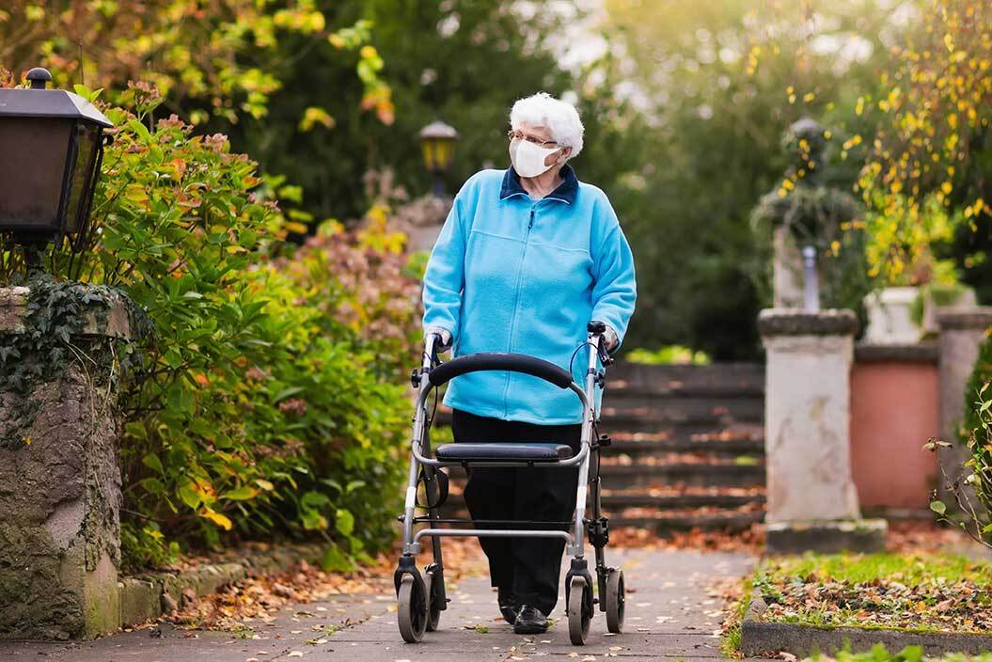
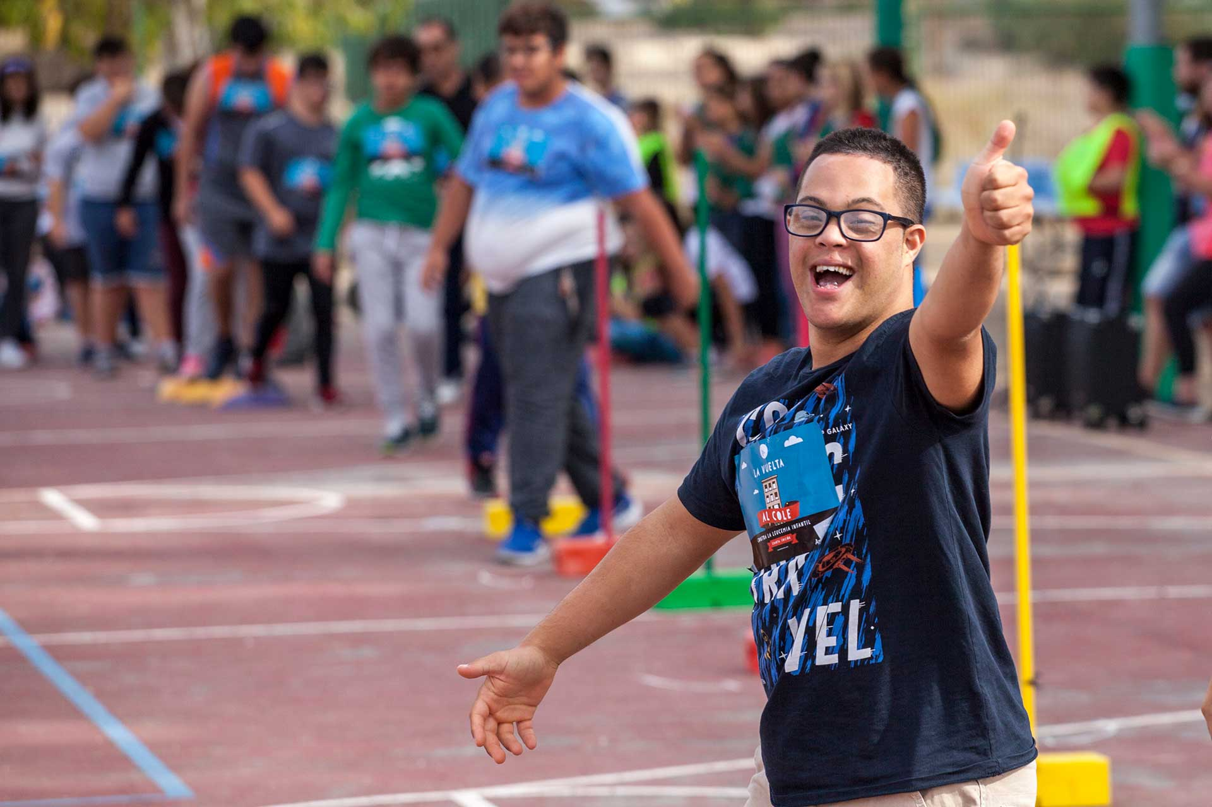
Disability experience and diversity (WHO, 2011)
The disability experience - the interaction of health conditions, personal factors, and environmental factors - varies greatly.
Persons with disabilities are diverse and heterogeneous.
A child born with cerebral palsy or the young soldier who lost his leg to a land-mine, or the older person with dementia are all people with disabilities.

Slide 11
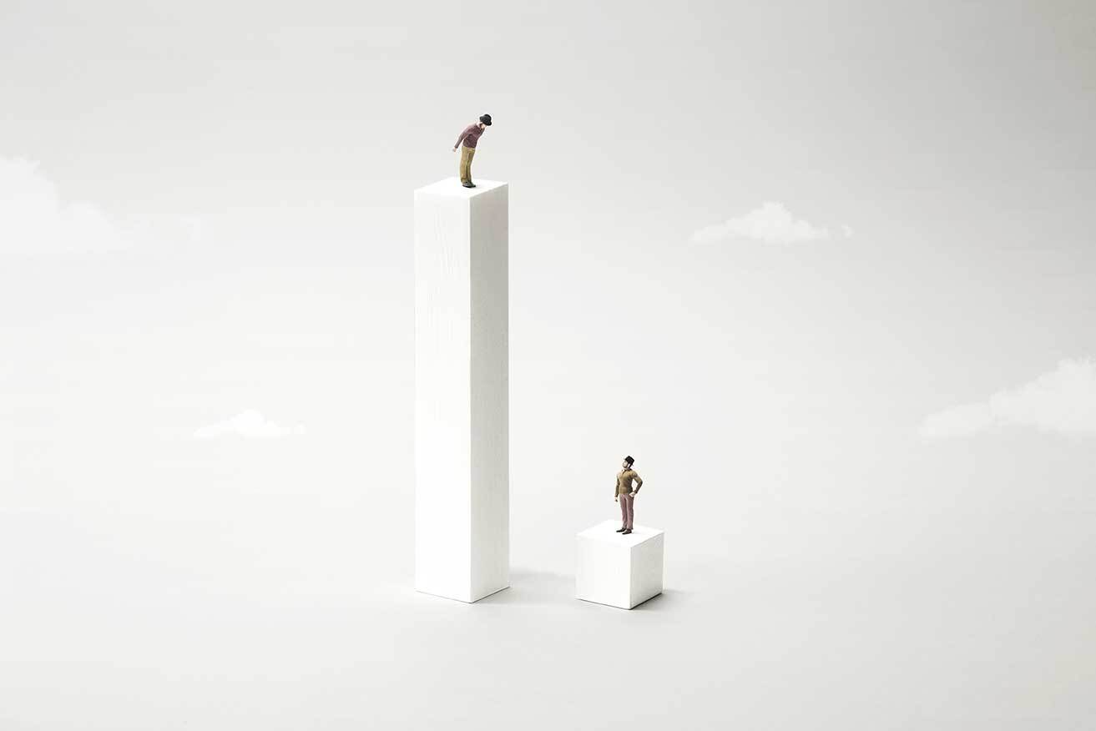
Health disparities and cultural competence (Butler et al., 2016)
People with disabilities experience many health disparities e.g., poorer self-rated health; higher rates of obesity, smoking, and inactivity; limited access to health care etc.
Cultural competence has been promoted as an approach that can reduce health disparities.
Nowadays, it has been expanded to other marginalized population groups (e.g., people with disabilities) who are at risk of stigmatization and/or who have different health care needs that result in health disparities.

Slide 12
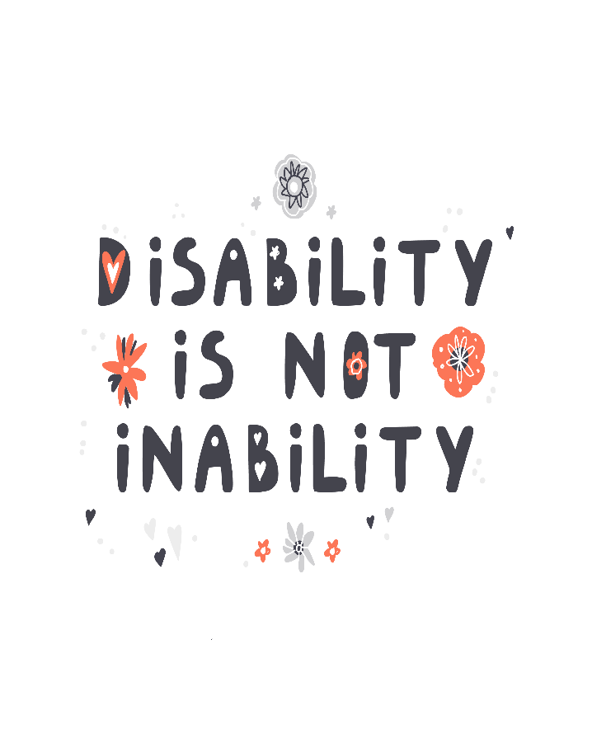
Disability inclusion (CDC, 2020)
Disability inclusion: Include people with disabilities in everyday activities and encourage them to have roles similar to their peers who do not have a disability.
They can fulfill socially expected life roles (being a student, a parent, a worker or a community member).
They can engage in social activities (using public resources, transportation, libraries or receiving adequate health care).
Disability inclusion is about understanding the relationship between the way people function and participate in society, while having the same opportunities for participation.

Slide 13
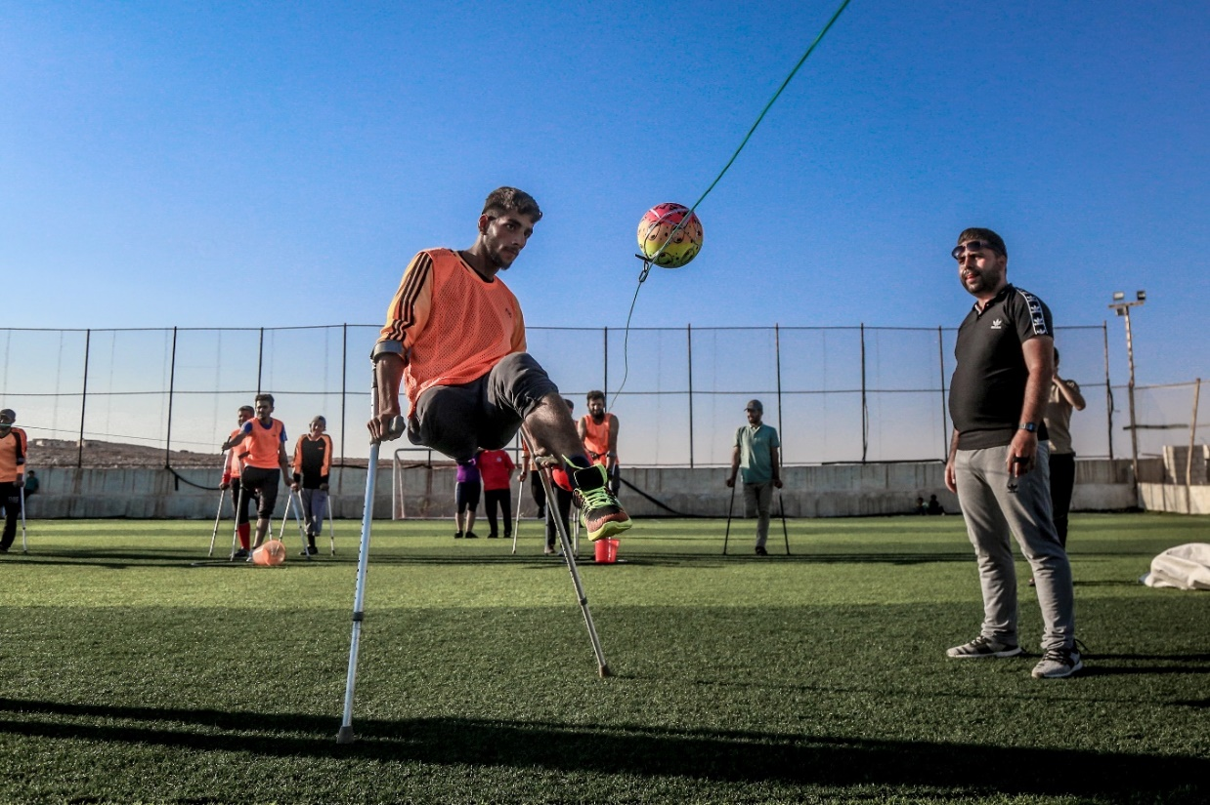
Disability as part of person’s identity
Our social identity is socially and historically constructed. It consists of the knowledge that one belongs to a social group and the significance that one ascribes to their group membership (Tajfel, 1974).
Disability identity: A sense of self that includes one’s disability and feelings of connection to or solidarity with the disability community. Disability has a unique role in one’s social identity (Forber-Pratt et al., 2020).

Slide 14
How culture affects our views about disability (Stone, 2005)
Beliefs about causality:
Cultural explanations about why and how a disability is caused e.g. it is a sign of bad luck or fate, or it is caused by a virus.
Valued and devalued attributes:
The personal attributes that a society or a cultural group finds important. Particular physical or intellectual attributes are valued or devalued by different societies.
Anticipated roles:
The roles that societies expect the individuals with disabilities to play, e.g. to be fully included and active or to be hidden.

Slide 15
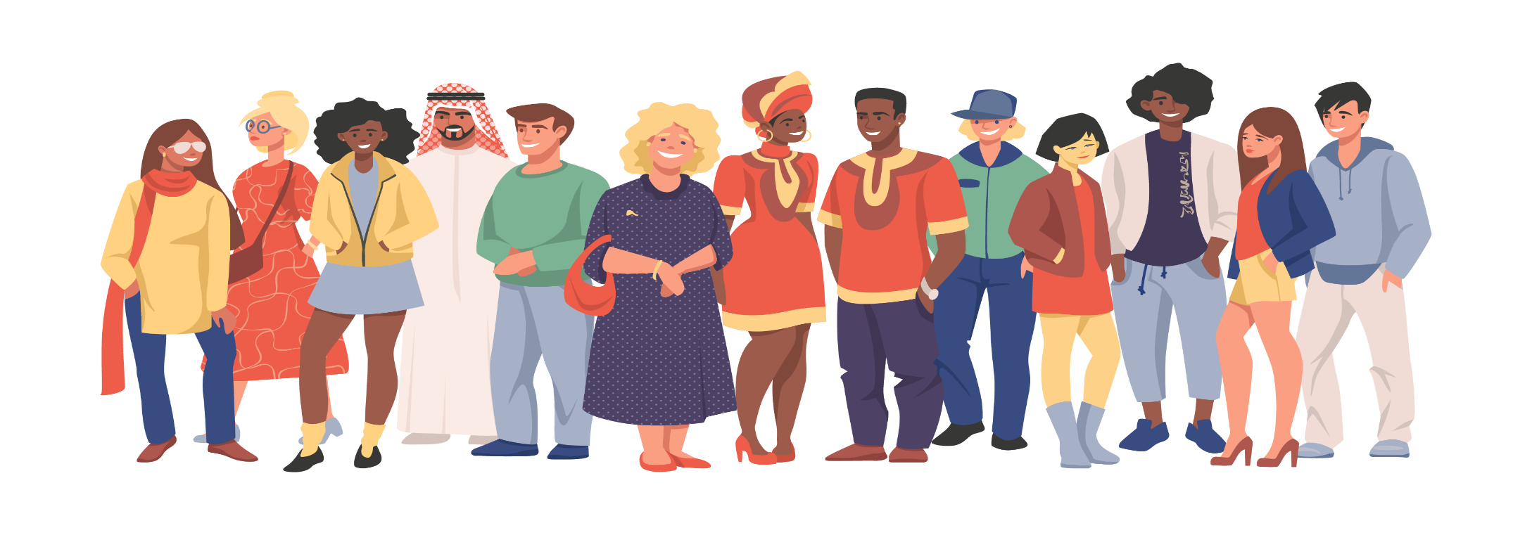

See and re-think
Look at the picture and write down your first thoughts about the possible identities of those portrayed. Then answer the questions:
1. Do you think that some of them might have a type of disability?
2. Which characteristics of the people give you information about their cultural characteristics e.g., country of origin, occupation, religion, sexual orientation, disabilities etc.?
Tip: Think about how stereotypes affect our thoughts.

Slide 16

Intercultural competence & disability for service providers (Stone, 2005)
Intercultural competence:
The ability to adequately understand and respond to the needs and concerns of individuals with disability and their families from ethnic and minority communities. The responses should have as a basis an accurate understanding of their specific cultural practices.
Disability:
Having knowledge of the general process of working with persons with disabilities from different cultures, whatever those cultures may be. To be competent, professionals need to understand the ways in which ‘culture’ may affect one’s views on ‘disability’.

Slide 17
The role of families in care giving
Families as facilitators
Provide psychological & emotional support
Participation in decision making
Provide adequate information about the patient/client
Families as barriers
Misunderstandings about care needs
Resistant
Uncooperative
Abusive
Family members play a significant role since they can be caregivers of people with disabilities, depending on the type of disability and their level of functionality.
They can act as facilitators for receiving the best care by the professionals or they can act as barriers for health and social care professionals in their communication with the patients/clients.

Slide 18
Interactions with person’s family members
What to do when you interact with your patients'/ clients' family members
Acknowledge the presence of the family member and identify the relationship between the patient/client and the family member.
Establish the role of the family member in decision making and remember that each case (and each family) is different.
Recognize and acknowledge any emotions expressed by the patient/client or family member.
Encourage the family member to be specific with the information she/he gives you.
If you consider it necessary, assess the patient/client in private (separate from the family member) for physical, emotional, or financial abuse or neglect.
Recognize the impact of patient’s/client’s health on her/his family and especially, if the family member is her/his only caregiver.

Slide 19
Good practice on intercultural care and disability
Thetis Program - Caring For Refugees With Disabilities
Social EKAB, a Greek NGO with the support of UN High Commissioner for Refugees (UNHCR) and ARSIS NGO, has been implementing a care program for refugees with disabilities since November 2017.
"Thetis" program aims to register all refugees with disabilities and launch an individual treatment-support program for each of them personally. This program is carried out through two specialized mobile teams in mainland Greece and a specialized network in the islands of eastern Aegean.
The teams have qualified personnel (social worker, physiotherapist, doctor, psychologist) and operate in places of residence of refugees with disabilities (camps or apartments). In addition, they work to connect disabled refugees with appropriate specialised care institutions. Also, the program aims to organise and encourage caregivers from the ethnic communities of refugees with disabilities for their daily support.

Slide 20

Exercise: A ballet dancer
Watch the video and write down your thoughts:
a. What is your opinion about the teenager? What do you think about her disability?
b. What do you think about her social identity? How would you categorize her e.g., member of dance community?
c. Do you think that this dancer breaks any stereotypes about disabled people? If yes, in what ways?
https://youtu.be/ezz93FrZYYY

Slide 21
Summary
Different individuals have different ways of viewing, interpreting and dealing with experiences of disability.
These can be influenced by several factors including personality traits, culture, religious beliefs, social environment, social stigma and many more.
Everybody is likely to experience disability at some point in their life.
Functioning and disability are results of the interaction between the health conditions of the person and their environment, thus the environment in which the disabled person lives plays a crucial role.
Service providers need to be culturally sensitive when interacting with patients and beneficiaries that have different backgrounds and a form of disability.

Slide 22
PSYCHOLOGY & MENTAL health PROBLEMS

Slide 23
Key facts on mental health & minorities (U.S. Department of Health and Human Services, 2001):
Racial and ethnic minorities have less access to mental health services than do white people. They are less likely to receive needed care and when they do, it is more likely to be poor in quality.
Racial and ethnic minorities have unmet mental health needs and may suffer a greater loss to their overall health and productivity.
Many disabled adults (ages 18-55) have a mental disorder contributing to their disability.

Slide 24
Definition of terms:
Mental Health:
The successful performance of mental function, resulting in productive activities, fulfilling relationships with other people, the ability to adapt to change and to cope with adversity.
Mental Health Problems:
Signs and symptoms of insufficient intensity or duration to meet the criteria for any mental disorder.
Mental Illness:
All mental disorders, which are health conditions characterized by alterations in thinking, mood, or behaviour (or some combination) associated with distress and/or impaired functioning.
Culture:
A common heritage or set of beliefs, norms, and values.

Slide 25
Intercultural competence & mental health
Underserved needs
Culturally competent care
Patient-centered care
Health literacy
The concept of cultural competence overlaps with several other concepts related to providing high-quality, appropriate care.

Slide 26
The clinical setting: Culture & mental health
Symptoms
Culture affects symptoms and their description by the patients.
Which ones they report.
Presentation
Culture affects the way people present their (mental) health problems.
What types of help they seek?
Meanings
Culture influences the meanings that people give to their (mental) illness.
Is an illness "real" or "imagined“? Is it of the body or the mind (or both)?
What types of coping styles and social supports they have?
Existence of culture-bound syndromes. (Sets of symptoms much more common in some societies than in others)
How patients describe their symptoms to their clinicians.
Does it warrant sympathy?
How much stigma surrounds illness and the particular condition?
What are the possible causes?
What type of person might experience it?
Do people seek help in the first place? And if so, for which symptoms?

Slide 27
Different interpretations of mental health
Causality and explanatory models for mental and psychosocial problems:
How people explain the cause of mental illness e.g., from virus, witchcraft, traumatic event, fate etc.
Expressions of distress and diagnosis:
How people express symptoms and how they diagnose them in their local area.
Concepts of self/person and the relationship of body, mind & soul:
How individuals see themselves.
Help seeking patterns:
Where individuals go for help and for what problems.
Stigmatization of mental illness:
To what extent people stigmatize mental health/illness.
Mental Health Systems:
How they are constructed across countries and what roles individuals attribute to them.

Slide 28

Factors that influence perceptions of mental health
Individual factors: Social identity, race, ethnicity, culture, religion, social class etc.
Family factors: Family environment, supportive, positive, problematic, abusive etc.
Social factors: Poverty, education, experiences of traumatic events, violence, migration, stigma etc.
Environmental factors: The broader social environment of the individual e.g., society, community, health system etc.

Slide 29


Factors that influence a professionals perception of mental health
The professionals are not ‘blank sheets’. They are individuals with personal biographies as well, that determine their views on mental health/illness.
Professional culture: A group of professionals can be said to have a "culture" in the sense that they have a shared set of beliefs, norms, and values.
Clinician bias and stereotyping of ethnic and racial minorities.

Slide 30

Exploring assumptions
Think about the following statements:
Our organisation is well-known and people will trust the information we give.
Almost all people suffer from health and mental health issues.
People from ethnocultural communities different to European cultures have very rigid beliefs about issues like mental health and they don’t see them as that important.
Questions for you to discuss:
What do you think of these statements? Are they correct or incorrect?
Do you find them problematic statements or not?
Are they unfounded generalizations or are they based on some truth?
Could this kind of statement add to the already established stereotypes for different populations?

Slide 31
Intercultural competence & Cultural safety
Intercultural Competence
The skills, attitudes, and behaviours needed to improve interactions between different cultures, whether within a society (differences due to age, gender, religion, socio-economic status, political affiliation, ethnicity, and so on) or across borders.
Cultural Safety
It goes beyond cultural competence and means taking responsibility for the way we view culture. It means that people of all cultural backgrounds work together respectfully and effectively with knowledge and awareness. It includes attitudes, behaviors, skills, policies and procedures.

Slide 32
Outline for Cultural Formulation - The clinician is encouraged to:
Ask about patient’s cultural identity
Examine cultural explanations of illness
To determine their ethnic or cultural reference group, language abilities, language use, and language preference.
Consider cultural factors – the psychosocial environment – the levels of functioning
E.g., patient’s idioms of distress, the meaning and perceived severity of their symptoms, past experiences with professional etc.
Assess cultural elements in patient-clinician relationship
Assessment on culturally relevant interpretations of social stressors, available support, levels of functioning, patients' disability etc.
Provide an overall cultural assessment for diagnosis and care
To determine differences in culture and social status between them and how those differences affect the clinical encounter (e.g., communication, rapport, disclosure etc).
the clinician synthesizes all of the information to determine a course of care.

Slide 33
What professionals can do to achieve cultural safety
To achieve cultural safety:
Understand your community.
Build links between health services and culture-based community organizations.
Provide helpful, tailored information in other languages.
Recognise cultural, medical or health practices.
Look at the whole person beyond cultural or any other geographical borders.
Look at the bigger picture and recognise that it’s difficult to separate mental health concerns, like depression, from larger concerns, like poverty or lack of housing.

Slide 34
Inequalities & mental health - The case of Covid-19 pandemic
A research survey of over 14,000 adults conducted by the mental health charity Mind in the UK (2020) revealed that existing inequalities in housing, employment, finances and other issues have had a greater impact on the mental health of people from Black, Asian and Ethnic Minority (BAME) groups than white people during the coronavirus pandemic.
“Last year I quit full time teaching and moved back home to save money. Being back at home caused my mental health to suffer, and just as I was trying to process those feelings, lockdown hit. Dealing with all of that – the lockdown, the isolation, the lack of friends etc. – was all piling onto me mentally. Then the Government statistics came out showing that Black people were at higher risk of dying from coronavirus and it put me in a downward spiral. A virus can’t discriminate, but there’s a system that’s been in place for years, that makes us more vulnerable.”
Dami, 27-year old

Slide 35

Case study
‘When my mother came from China for an extended time to attend my wedding in 2001, it was the most special period in my life. A strong-willed person, my mother was full of life and the most generous human being I've ever known. But within six months of her arrival in Italy, I noticed a dramatic change in her physical, mental, emotional and spiritual well-being. It was clear that she was experiencing a profound culture shock in every sense possible, a shock that was compounded by her difficulty with the English language, the lack of her cultivated community support and the absence of her own friends. She could not engage in any of her familiar daily activities or social networks here. The strong, happy and healthy person I loved so much was now displaying all the signs of stress, loneliness and depression brought on by social isolation.”
Discussion:
Discuss in groups of 2 the following questions:
How could the daughter help her mother? What steps should she follow?
What the professionals in your countries would suggest her to do?
If the mother asked for the help of a counsellor, what could be the possible barriers to this being successful?

Slide 36
Summary
Different individuals have different ways of viewing, interpreting and dealing with mental health and experiences of mental health problems.
These can be influenced by several factors including personality traits, culture, religious beliefs, social environment, social stigma and many more.
Culture affects the symptoms, their presentation and the meanings that different people attribute to them.
Practitioners and professionals that work with people from different cultural backgrounds should take into account the cultural traits when interacting with them, in order to provide culturally sensitive care.

Slide 37

Reflection and Action Plan
Identify 3 things you have learnt from this module.
1
2
3
Write down 3 actions you will take/ behaviours you will change, as a result of your learning.
1
2
3

Slide 38
Literature & recommendations for further reading

Slide 39
Good practice on intercultural care and mental health
Canada: Multicultural Mental Health Research Centre
Patient Information by Language
The website provides useful resources about several mental health issues in 25 languages.
The resources come from reliable sources, such as Canadian mental health hospitals, research centers and non-profit agencies for mental health.
Information can be accessed in different languages about multiple themes that can influence their mental well-being such as adaptation to a New Country, Addiction, Alzheimer’s and Dementia, Anxiety, Bereavement, Bipolar Disorder, Mental Illness and many more.

Slide 40
Disability
Aruma (n.d.) Types of disabilities. Retrieved from https://www.aruma.com.au/about-us/about-disability/types-of-disabilities/
Butler M, McCreedy E, Schwer N, Burgess D, Call K, Przedworski J, Rosser S, Larson S, Allen M, Fu S, Kane RL. (2016). Improving Cultural Competence To Reduce Health Disparities. Comparative Effectiveness Review No. 170. (Prepared by the Minnesota Evidence-based Practice Center under Contract No. 290-2012-00016-I.) AHRQ Publication No. 16-EHC006-EF. Rockville, MD: Agency for Healthcare Research and Quality; www.effectivehealthcare.ahrq.gov/reports/final.cfm.
CDC (2020). Disability Inclusion. Retrieved from https://www.cdc.gov/ncbddd/disabilityandhealth/disability-inclusion.html
Disabled World (2019). Disabilities: Definition, Types and Models of Disability. Retrieved from https://www.disabled-world.com/disability/types/
Forber-Pratt, A. J., Merrin, G. J., Mueller, C. O., Price, L. R., & Kettrey, H. H. (2020). Initial factor exploration of disability identity. Rehabilitation psychology, 65(1), 1–10. https://doi.org/10.1037/rep0000308
Stone, J. H. (2005). Culture and Disability; Providing Culturally Competent Services. California: SAGE Publications https://books.google.gr/books?hl=en&lr=&id=0QVzAwAAQBAJ&oi=fnd&pg=PP1&dq=intercultural+competence+and+disability&ots=4eNDITmNf6&sig=1R_UCvfrhyF7YdcYLs-JGM3XoY4&redir_esc=y#v=onepage&q&f=false
Tajfel H (1974). Social identity and intergroup behavior. Social Science Information, 13(2), 65–93. [Google Scholar]
WHO (2011). World Report on Disability. Geneva. ISBN: 9789241564182. Retrieved from https://www.who.int/publications/i/item/9789241564182
World Health Organization (2013). How to use the ICF: A practical manual for using the International Classification of Functioning, Disability and Health (ICF). Exposure draft for comment. Geneva: WHO https://www.who.int/docs/default-source/classification/icf/drafticfpracticalmanual2.pdf?sfvrsn=8a214b01_4

Slide 41
Psychology & Mental Health Problems
Canadian Mental Health Association, BC Division (2014). Cross-cultural Mental Health and Substance Use. Retrieved from https://www.heretohelp.bc.ca/infosheet/cross-cultural-mental-health-and-substance-use#A
U.S. Department of Health and Human Services. (2001). Mental Health: Culture, Race, and Ethnicity—A Supplement to Mental Health: A Report of the Surgeon General. Rockville, MD: U.S. Department of Health and Human Services, Substance Abuse and Mental Health Services Administration, Center for Mental Health Services.
Mind (2020). The mental health emergency: how has the coronavirus pandemic impacted our mental health? London: Mind. Available at www.mind.org.uk
Multicultural Mental Health (n.d.). Cultural Formulation; DSM-5 Cultural Formulation Interview (CFI). Retrieved from https://multiculturalmentalhealth.ca/clinical-tools/cultural-formulation/

Slide 42


