Slide 1
INTERCULTURAL Communication
Module 2:
Trainer’s Presentation

Slide 2
After completing this module you will be able to:
Identify the pitfalls in intercultural communication
Have strategies available to overcome intercultural communication pitfalls
Have strategies available to overcome language barriers
Have strategies available to solve intercultural conflicts

Slide 3
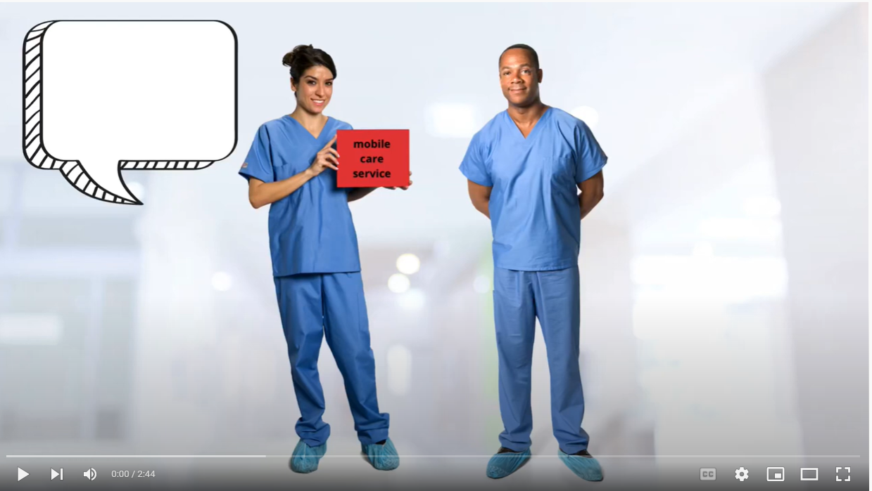

Meet Eva and Ben

Slide 4
INTERCULTURAL COMMUNICATION PITFALLS

Slide 5
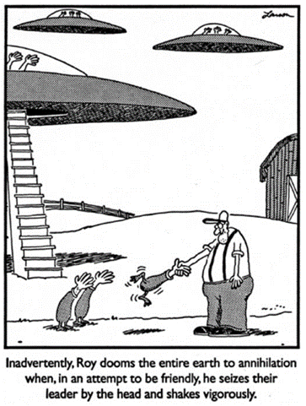

What is happening here? What pitfall can you recognise in this situation?
Source: Larson, Gary (2014): The complete farside.

Slide 6
Pitfalls in intercultural communication: Language differences
Language differences = obvious barrier to intercultural communication
Dialects, different accents and slang can cause problems even if you speak the same language
Words do not necessarily translate exactly from one language to another.
If an interpreter is used, the characteristics of the conversation can change as a third person comes in

Slide 7
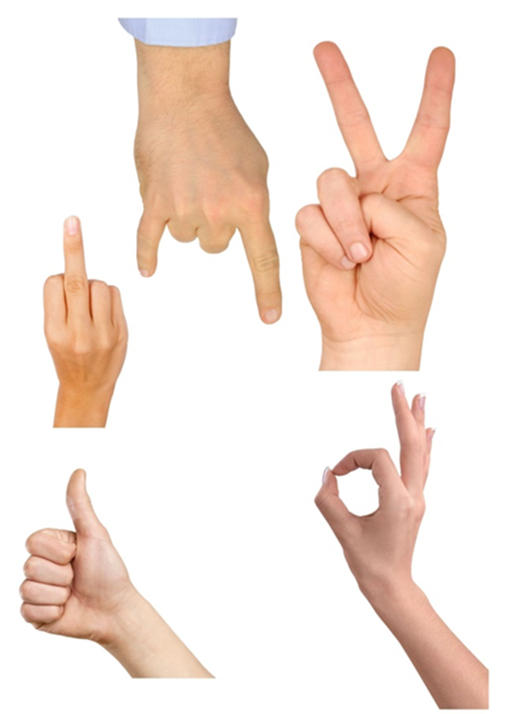

Pitfalls in intercultural communication: Non-verbal communication
Distance: which distance feels comfortable for you when talking to a stranger? Try it out! Have you ever been in a situation where your conversation partner did not keep the “appropriate distance”? How did it effect your conversation?
Gestures: Do you know the meaning of the gestures on the pictures in at least two different cultures? Do you know what they mean in your own culture?
Mimics: Discuss what it means in your cultural context to look someone straight into the eyes. Can you think of other examples?

Slide 8
Pitfalls in intercultural communication: Stereotyping
Stereotypes and prejudices can influence the way we communicate with each other
There are negative as well as positive stereotypes
An increased awareness about the effects of stereotyping can minimise the negative impacts that can result from them
A self-reflective attitude comprises of: acknowledging the existence of our preconceptions, understanding how they impact us, slowing down, checking it out and getting information
Heaven is where the police are British, the chefs Italian, the mechanics German, the lovers French, and it‘s all organized by the Swiss.
Hell is where the police are German, the chefs are British, the mechanics French, the lovers Swiss and it‘s all organised by the Italians.

Slide 9

Pitfalls in Intercultural Communication: Communication Styles
Which cultural communication difference is described with the picture?
Describe a situation where you have met a similar difference at your workplace
Title of the picture: Tackling problems. Source: Yang Liu – East meets West (2010)

Slide 10


Pitfalls in Intercultural Communication: Communication styles
Which cultural communication difference is described in the picture?
Describe a situation where you have met a similar difference at your workplace
Title of the picture: Anger Source: Yang Liu – East meets West (2010)

Slide 11


Pitfalls in Intercultural Communication: Communication styles
Which cultural communication difference is described in the picture?
Describe a situation where you have met a similar difference at your workplace
Title of the picture: Opinion Source: Yang Liu – East meets West (2010)

Slide 12


Pitfalls in Intercultural Communication: Communication styles
Which cultural communication difference is described in the picture?
Describe a situation where you have met a similar difference at your workplace
Title of the picture: In a restaurant Source: Yang Liu – East meets West (2010)

Slide 13


Pitfalls in Intercultural Communication: Communication styles
Which cultural communication difference is described in the picture?
Describe a situation where you have met a similar difference at your workplace
Title of the picture: Self-portrayal Source: Yang Liu – East meets West (2010)

Slide 14


Pitfalls in Intercultural Communication: Communication styles
Which cultural communication difference is described in the picture?
Describe a situation where you have met a similar difference at your workplace
Title of the picture: Boss Source: Yang Liu – East meets West (2010)

Slide 15

Intercultural communication pitfalls
Think of some examples of intercultural communication pitfalls at your workplace?
Which are the most common ones?
Which tools and approaches do you currently use to overcome them?
Where do you see space for improvements?
REFLECTIVE SUMMARY

Slide 16
Summary
There are many pitfalls which can occur when people from different cultures communicate.
You will never be able to know all the specific communication codes of the cultures you will meet at your workplace.
But you can be aware that not everybody communicates the way you do and that even if you say something with good intentions it might be understood differently.

Slide 17
BRIDGING INTERCULTURAL COMMUNICATION BARRIERS

Slide 18
Expressing yourself in a foreign language
Use a language that you have learnt or if you do not speak a foreign language use body language to explain:
The way from your workplace to the next public transport station
The different qualifications of the people who work at your workplace
Possible side effects or complications after a surgery
- What you had for dinner last night

Slide 19
Bridging barriers to intercultural communication: choosing the appropriate means
Content and aim of the communication | Means of communication
Simple messages and acting recommendations for your patient/client | Body language and gestures, pictograms
Daily communication with the patient/client | Translation-Apps, bilingual colleagues
Emergency situations and other unexpected situations | Bilingual colleagues, any people around speaking the language of the patient/client, ideally a professional interpreter
Explaining medical terms | Translation-apps or dictionary
Planned conversations where a detailed understanding is necessary | Professional interpreters

Slide 20
Bridging barriers to intercultural communication: Using interpreters
In which situation it is necessary to involve an interpreter.? If it is a complex conversation with many details and/or sensitive issues? > Yes
Who will be the interpreter? Can it be a bilingual colleague or is there a need for a professional interpreter? Be careful with using family members as interpreters > role conflicts.
Where to find an interpreter? Are in-house interpreters available? Established system for finding interpreters? Bilingual resources within own team? Professional interpreters can be found in the internet or via local initiatives.
Plan a preparatory as well as a follow-up conversation with the interpreter

Slide 21
Bridging barriers to intercultural communication: using interpreters (cont.)
Structuring the conversation when using interpreters:
Opening the conversation:
Introduce the persons present
Explain the need for interpretation and the role of the interpreter
During the conversation:
Try to place the seats in a circle or triangle
Establish eye contact with your patient/client
Choose a simple and clear language
Observe the non-verbal language of your patient/client

Slide 22
Bridging barriers to intercultural communication: using interpreters (cont.)
- Make sure the interpreter is culturally appropriate in terms of gender, ethnic group etc.
- Make sure that the selection of the interpreter maintains the client’s privacy
- Spend time with interpreters first and prepare the situation together
- Review the interpreter’s roles and procedures and provide in-service training if necessary
- Speak in short, simple, jargon-free sentences, so interpretation is easier. Ask the same question in different ways.
- Avoid colloquialism, idioms, slang, similes
- Encourage the interpreter to translate literally rather than paraphrase
- Look and speak directly to your patient/client, not the interpreter, even though the client does not understand
- Listen even though you may not understand the language
- Look for nonverbal cues
- Have the interpreter ask the patient/client to repeat the information communicated, to see if there are any gaps in understanding
- Be patient as using an interpreter is not easy for any of the parties involved

Slide 23
Bridging barriers to intercultural communication: Translation Apps
PONS Online Translator:
translates complex sentences into the desired language with the help of the DeepL service.
text field and a microphone symbol for voice input via Google Assistant
includes advertisements.
Microsoft Translator:
language input and text input.
photo recognition recognises words and texts on photographed objects
conversation function
free of charge and completely ad-free
Google Translator:
text and voice input + photo recognition, handwriting input and conversational translation
conversation translator immediately interprets what is said and reads the input aloud
possibility of downloading all dictionaries as an offline version
free of charge and completely ad-free.

Slide 24
Bridging barriers to intercultural Communication: Non-verbal communication
Showing and demonstrating: Whatever can be shown directly to your patient/client should be shown, e.g. the way to the bathrooms, the way any devices should be used, etc.
Using pictograms: these can be cards with drawings or photos of things or locations that are part of the daily routines for taking care of the patient like food, water, bathroom etc., the patient/client can point on the card/photo to communicate.
Dictionary without words: you may use a dictionary which includes pictures instead of words, these can be bought or be self made
“Dolometer”: this is a scale from “no pain” until “unbearable pain” which gives the patient the possibility to express the level of pain nonverbally
Music and art can be used as ways of non-verbal communication

Slide 25
Bridging barriers to intercultural communication: using simple language
Simple vocabulary
Simple numbers and characters
Simple sentences
Simple text
Simple layout and pictures

Slide 26

Communication guidelines for your workplace
Put the communication tips into practice by choosing one of the following tasks to be elaborated in small workgroups:
Choose a typical communication situation in your daily work and design a guide for communication with patients/clients who do not speak your language. OR
Create a draft for a flyer about your service for a non-native target group using simple language.

Slide 27
Summary
There are many ways and tools to bridge communication barriers with your patients or clients.
The most important aspect is to build a good and trustful relationship.
This can be even achieved with non-verbal means.
In other cases you might need to use other means to support verbal communication.
Always consider the specific requirements of the situation to choose the appropriate means for communicating with your clients/patients.

Slide 28
Solving intercultural conflicts

Slide 29
Solving intercultural conflicts: Dealing with Cultural Shock
It may happen that we are even shocked by an attitude based on a different cultural orientation that we may not share. This may lead to conflicts that can be difficult to handle.
Margalit Cohen-Emerique has developed a diagnostic method for critical incidents that cause feelings of a cultural shock for the persons involved.
Cohen-Emerique, defines a cultural shock as the emotional and intellectual experience happening when getting in touch with what is foreign to us.
This creates emotions such as incomprehension, fear and surprise. If this cultural shock is not recognized and processed, it can lead to defensive reactions.

Slide 30
Solving intercultural conflicts: Dealing with Cultural Shock
Margalit Cohen-Emerique (1999) describes three steps that can help to overcome a cultural shock:
Decentration: Clarify the shock on the emotional level first. What do you feel? What exactly causes these feelings?
Entering the other person's reference system: The next step is to give meaning to each other's attitudes by exploring their different cultural affiliations.
Negotiation: Negotiation means neither submission nor passive resistance from one or the other. It is a true encounter. Here it is a matter of finding a new norm, a common field or a "3rd space" in which everyone preserves his or her identity and at the same time understands the perspective of the other.

Slide 31

Reflection and Action Planning
CONSIDER:
What I have learnt about myself and my own cultural background?
What I have learnt about intercultural communication?
What else would I like to know?
What changes will I make in my current practise to ensure that all cultural considerations are in place for the people for whom I care?

Slide 32


