Slide 1
Body, gender, sex, & intimacy
Module 5

Slide 2
Learning Objectives
By the end of this module learners will:
Understand
the difference between sex and gender
Understand
different attitudes associated with sex and sexuality
Understand
the relationship between culture and gender/bodies
Detect
gender roles across cultures
Reflect
on our cultural identities and how they create real life intercultural communication problems
Apply
Engage
critically with cultural differences regarding gender and sex
effective tools to overlap the cultural gap when caring for persons from another culture

Slide 3



Introduction
A friend of mine described a very difficult situation that she dealt with.
One day an Iranian mother and father admitted their thirteen month old child to the pediatric unit where she works. After three days of rigorous testing and examination it was discovered that Ali had Wilm’s tumor, a type of childhood cancer.
Fortunately, the survival rate is 70-80% with proper treatment.
Before meeting with my friend, who is a pediatric oncologist to discussed Ali’s treatment. Mr. and Mrs. Mohar were frightened yet cooperative.
After meeting her, however, they became completely uncooperative. They refused permission for even the most routine procedures. Mr. Mohar would not even talk with the physician or the nurses. Instead, he called other specialists to discuss Ali’s case.
After several frustrating days my friend decided to turn the case over to a colleague. He met with the Mohars and found them extremely cooperative.
What caused their sudden reversal in behaviour? What would you do in her place?
audio
Source: pixy.org

Slide 4
Questions
Why do we have to be aware of different perceptions of sex and gender?
Why is this awareness relevant to healthcare professionals?

Slide 5

An example
Poor woman…
A twenty-eight-year-old Arab man named Abdul Nazih refused to let a male lab technician enter his wife’s room to draw blood. She had just given birth.
What??????
But I still have to do my job… whether he agrees or not..
Source: pixabay.org

Slide 6
Sex and gender

Slide 7
Sex and gender
“One is not born a woman, but rather becomes, a woman.”
Sex: set of biological and physiological features that define masculine and feminine
Gender: socially and culturally constructed identities/roles regarding male and female
Gender identity: how someone perceives themselves regarding gender. Gender identity is not binary or static.
Sexual orientation: to which gender one person is attracted to

Slide 8
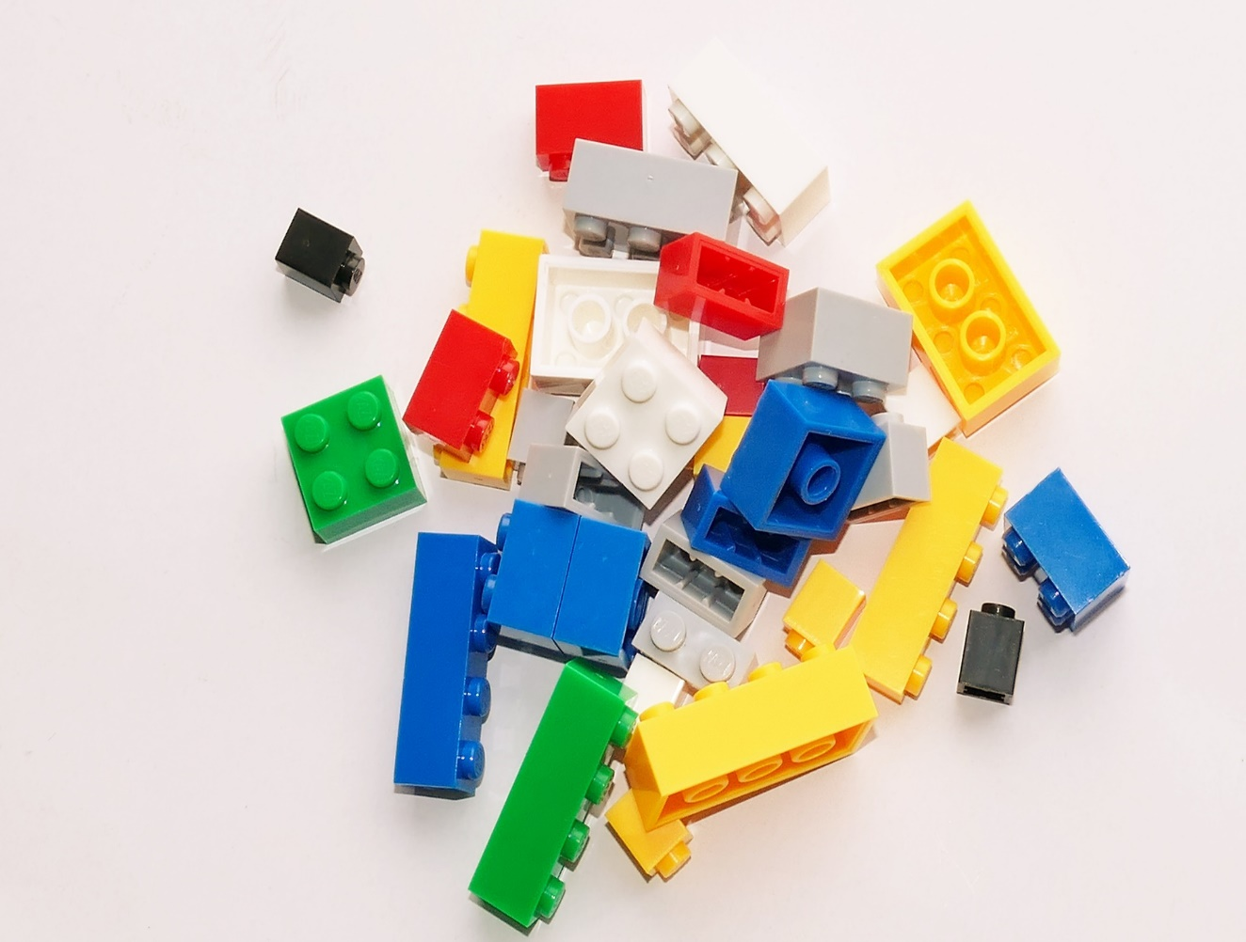
Social constructionism
Social constructionism
Everything we see and know is partially socially constructed. Meaning does not exist out of social circumstances and is dependent upon them. Gender theorists draw from this theory to analyse gender issues.
Source: pexels.com

Slide 9
Gender performativity
Gender Performativity
Identity is constructed and reconstructed through repetitive acts. People tend to conform because of social pressure, but there is also the possibility to resist. This is how different gender identities are formed.
Gender “is a performative accomplishment compelled by social sanction and taboo…. Gender is… an identity instituted through a repetition of acts.”
Judith Butler

Slide 10
Gender as a social construction
Actions
Divert from those norms
Implement social norms and stereotypes about genders
The implementation of traditional norms and stereotypes about enhances the
Nature of woman
Nature of man
The distinction between them (binarism)

Slide 11
Gender as a social construction
What are little boys made of?
Snips and snails,
And puppy dog tails,
That’s what little boys are made of.
What are little girls made of?
Sugar and spice,
And everything nice,
That’s what little girls are made of.

Slide 12

Sugar and Spice
Reflect on the lyrics of this familiar nursery rhyme
What message do we get from this rhyme in relation to gender?
How do we perceive these perceptions today in the West?
Think about how gender roles vary over time and in different parts of the world

Slide 13
Summary
Sex refers the biological features that differentiate masculine and feminine, while gender is the socially and culturally constructed identity.
Gender Performativity theory states that gender identity is constructed and reconstructed through repetitive acts.
Our daily actions either implement the social norms or divert from those norms.

Slide 14
Body

Slide 15
Bodies
Body is an important element of a person’s identity. It is the vessel through which identities, cultural or individual, are expressed.
Cultures and sub-cultures, such as class, religion and nationality affect the way people perceive themselves and others.
Across different cultures there are different perceptions of body.

Slide 16
Bodies (cont.)
Perceptions of the body differ not only between cultures but also change over time. Societies are not static, but change constantly (BODY Culture, Body, Gender, Sexuality in Adult Trainings, 2013).
What is considered to be acceptable depends on the particular cultural context. For example, tattoos and piercings may be common within one culture, but unacceptable and a reason of discrimination in other cultures.

Slide 17
Differences regarding body perceptions
Life stages
Everyday life of the body
Fashion
Non verbal communication
Functions of the body
Pain
Health

Slide 18

Reflect on the situation in your country:
Would it be accepted for a teacher in a school or university to have lots of tattoos?
Are people with many piercings face any discrimination in the work environment?

Slide 19
Summary
Identities and cultures are expressed through the body.
There is no such thing as natural when we talk about bodies.
Body perceptions change across cultures and over time.
What is considered acceptable is defined by our culture.

Slide 20
Culture and GENDER ROLES

Slide 21
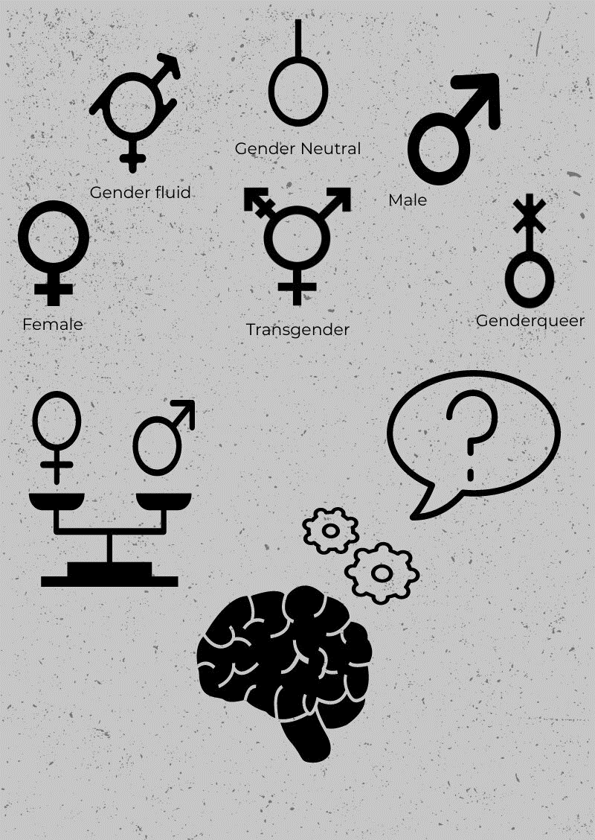
Culture and Gender roles
Cultural anthropology challenged the common belief, that humans are the same everywhere. It showed that several aspects of human existence and life, like sexuality, emotions, social relations and structures differ largely depending on the culture.
Made with Piktochart.com

Slide 22
Culture and Gender roles
Sexuality is a major aspect of each cultural, national and ethnic identity.
Normative Heterosexuality:
defines what sexual identity, orientation and behaviour is acceptable inside the borders of a nation and a culture.
deviations from the rules are not only unacceptable but also fought against because they disturb the cultural, national or ethnic ideological construct.

Slide 23
Culture and Gender roles
Masculine societies gender emotional roles are clear and very different - men are expected to be authoritarian and tough, while women should be gentle and soft
Feminine societies boundaries between genders are more fluid and less clear
Each culture determines the gender roles inside its boundaries. These roles are produced through communication, because communication influences and shapes our ideologies and mentalities. It also affects the differences regarding gender roles. The differences between gender roles and gender manifestations are expressions of specific values and norms (Neculaesei, 2015).

Slide 24
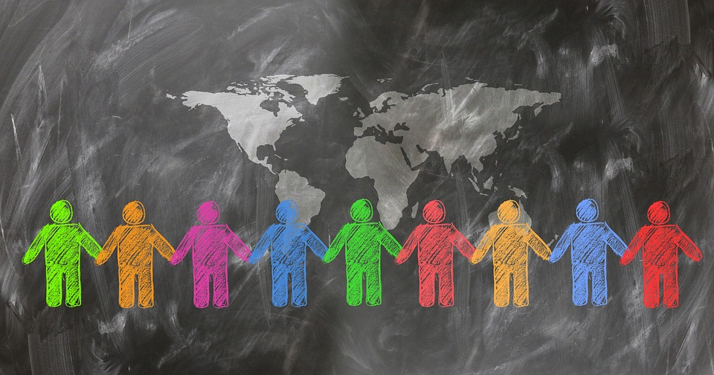
Culture and Gender roles
Different cultures view gender expressions and gender roles differently. The power distribution between genders should not be considered as ‘normal’ in any culture, because it is time and space related. The established power relations are not stable, but rather dynamic. What people from one culture see as restriction, others see it as normality.
Source: pixabay.com

Slide 25
Exercise
What kind of culture do you live in?
What are the potentials for a change of power relations between the genders?
Reflect on recent cases and debates that have arisen in your country regarding gender, gender equality and gender roles.

Slide 26
Summary
Cultural anthropology has shown that sexuality, emotions, social relations and structures differ from culture to culture.
Gender roles can be influenced by ethnic and racial identity.
Each culture determines its own gender roles
Masculine vs. feminine societies
The existing power relations between genders is not stable.

Slide 27
Intimacy

Slide 28
Individualism vs collectivism
Intimacy differs across cultures. These differences are connected with the notions of individualism and collectivism. (Marshall, 2008)
Individualism
verbal, explicit, direct, and expressive communication styles place greater emphasis on self-disclosure for enhancing intimacy
belong to a greater number of in-groups potentially risking self-disclosures may have fewer social consequences
Collectivism
indirect, nonverbal, ambiguous, contextual, and less expressive communication styles place less emphasis on self-disclosure
tightly knit networks increase the likelihood that inappropriate disclosures will be criticized very negatively

Slide 29
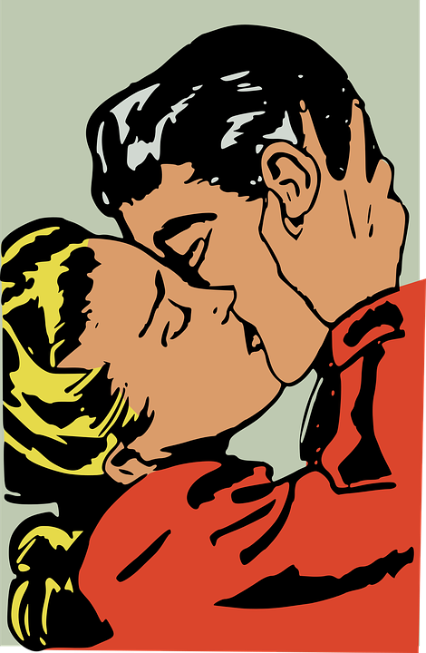

Quiz
Imagine you are a young girl in ancient Hindu culture. What kind of kiss would you use?
a. French kiss: an amorous kiss in which the participants' tongues extend to touch each other's lips or tongue
b. Throbbing kiss: when our lower lip moves our lover's lower lip but not the upper.
c. Pressed kiss: when we press our lover's lower lip with much force
d. Touching kiss: when our tongue touches our lover's lip and, closing our eyes, our hands touch our beloved's
Source: pixabay.com

Slide 30

Quiz
The correct answer is:
b. Throbbing kiss: when our lower lip moves our lover's lower lip but not the upper
Source: https://giphy.com

Slide 31
Summary
Intimacy is different in cultures of collectivism and individualism.
Individualism cultures enhance intimacy and individuals adopt expressive communication styles.
Collectivism cultures prefer indirect, nonverbal, non expressive communications styles.

Slide 32
Intercultural competence IN healthcare

Slide 33

Intercultural communication and gender
Intercultural terms
Multicultural
Racism
Intercultural
Immigrant
Culture
Gender Terms
Sexuality
Feminism
Sexism
Gender
Sex
Common Terms
Stereotype
Discrimination
Tolerance
Equality
Socialization
Minority

Slide 34
Intercultural competence and gender
It is not necessary
It is necessary
to have expert knowledge and understanding of every aspect of gender roles and sexual identity
to understand the diversity and fluidity of gender roles and sexual identity
to be aware of and able to reflect upon our own and others cultural norms
to demonstrate an ethical and tolerant approach

Slide 35
Intercultural competence in healthcare
Intercultural competence in the healthcare sector is a very important element of care
Intercultural competence regarding gender/body
Ability to engage in effective dialogue and tackle with difficult topics
Understand the patient and provide high quality treatment

Slide 36

Intercultural competence in healthcare
How to overlap cultural gap
Have understanding
Establish trust
Put aside stabilized beliefs
Source: pixy.org

Slide 37
Case study (1)
Lamar Johnson, a thirty-three-year-old African American patient had been deemed a “frequent flyer” (a term used to describe those who keep coming to the hospital for the same reason, often assumed to be drug seekers) by the nurses and doctors in the emergency department. Each time he came in complaining of extreme headaches he was given pain medication and sent home. On this last admission, he was admitted to the ICU, where Courtney, a nurse, had just begun working. When she heard him described as a frequent flyer, she asked another nurse why he was thought to be a drug seeker. She was told, ‘He has nothing else better to do; I’m not sure why he thinks we can supply his drug habits.;
What are your thoughts after reading this story?
How would you describe the behaviour of the health personnel?
What would you do if a person like Lamar Johnson appeared at the hospital/facility where you work and had the same symptoms?

Slide 38
Case study (1)
Although Courtney says her instincts told her that something else was going on, she saw his tattoos, observed his rough demeanor, and went along with what everyone else was saying. While she was wheeling him to get a CT scan, Mr. Johnson herniated and died. It turned out that he had a rare form of meningitis and truly was suffering from severe headaches. If some of the staff had not stereotyped him as a drug seeker on one of his earlier visits, perhaps his life could have been saved. This incident left a lasting impression on Courtney, who vowed never to judge a patient on his looks, and to trust her instincts, rather than let others influence her nursing care.
Would you do anything differently now that you have read the ending of this story?
Do you believe that his tattoos affected the behaviour of the health personnel?

Slide 39
Case study (2)
Amiya Nidhi was a young woman in her twenties who had recently immigrated to the United States from India. She was in the hospital to give birth. Her support person was her sister, Marala. Marala kept telling her to have an epidural, but Amiya said that even though she would like one, she could not get one; her husband would not allow it.
What do you think about the relationship between Amiya and her husband?
How do you feel about Amiya?
How would you manage this situation as a health care provider?

Slide 40
Exercise/ Case study
What Amiya’s nurse actually did:
Cindy, her nurse, overheard the conversation. Having learned that husbands are the authority figure in the traditional Indian household, she went to speak with Mr. Nidhi. She explained why an epidural would be advisable. She said that he seemed pleased that she came to him about it. He said he would think about it and let her know. About thirty minutes later, he came to Cindy and told her that he would like his wife to have an epidural. Everyone was pleased. By using cultural competence, Cindy helped her patient get the care she wanted, while still respecting the authority structure within the family.

Slide 41
Summary
Intercultural competence regarding gender/body is the ability to engage in effective dialogue and tackle difficult topics.
Intercultural competence regarding gender/body means:
to understand the relativity of right and wrong
to self reflect and be open to diversity
to understand ourselves and our cultural norms

Slide 42
General Summary
Gender identities are formed through repetitive acts that tend to conform to social pressure.
Body is the vessel through which identities, cultural or individual, are expressed.
Perceptions of body differ across cultures and over time.
Each culture determines its own gender roles.
The power distribution between genders is also dependent on time and culture.
Differences regarding intimacy are connected with the notions of individualism and collectivism.
Intercultural competence in healthcare sector requires an understanding of and respect for the diversity of sexual and gender norms.

Slide 43
Reflections
Consider 3 examples from the past when you would have benefited from increased understanding and cultural competence with regards to gender roles/the body:
1.
2.
3.
What would you do differently now as a result of your learning?

Slide 44
Further information
https://ec.europa.eu/eurostat/cache/infographs/womenmen/index.html?lang=en
https://open.lib.umn.edu/sociology/chapter/11-1-understanding-sex-and-gender/
https://opentextbc.ca/introductiontosociology/chapter/chapter12-gender-sex-and-sexuality/#:~:text=Sex%20refers%20to%20physical%20or,with%20being%20male%20or%20female.
https://plato.stanford.edu/entries/feminism-gender/#SexDis
https://courses.lumenlearning.com/cochise-sociology-os/chapter/the-social-construction-of-gender/
https://opentextbc.ca/socialpsychology/chapter/person-gender-and-cultural-differences-in-conformity/

Slide 45
References
Waterford One World Centre, Asamblea de Cooperacion por la Paz, CEMEA Aquitaine, & CEMEA Piemonte. (2011). The Gender and Intercultural Awareness Network Resource for Teachers and Trainers. Waterford One World Centre. Retrieved January 29, 2021, from http://wp5.developmenteducation.ie/resource/the-gender-and-intercultural-awareness-network-resource-for-teachers-and-trainers/
BODY Culture, Body, Gender, Sexuality in Adult Trainings. (2013). BODY IN CULTURE – CULTURE IN BODY. http://www.bodyproject.eu/media/Final-anthology-mht-May2013.pdf
Galanti, G. A. (2014). Caring for patients from different cultures. University of Pennsylvania Press.
Marshall, T. C. (2008). Cultural differences in intimacy: The influence of gender-role ideology and individualism—collectivism. Journal of Social and Personal Relationships, 25(1), 143–168. https://doi.org/10.1177/0265407507086810
Neculaesei, A.-N. (2015). CULTURE AND GENDER ROLE DIFFERENCES. Cross-Cultural Management, 31–35.

Slide 46


