Slide 1
Pregnancy, childhood, parenthood and family structures
Module 6

Slide 2
On completion of this module you will be able to:
Understand different approaches to pregnancy, giving birth, childhood and parenting
Work with (expecting) parents, children and families in a culturally sensitive way
Support inclusion of diverse families
Understand the dynamics of violence within families across cultures
Avoid cultural bias

Slide 3
Pregnancy and giving birth in different cultures

Slide 4
Traditions and beliefs about pregnancy around the globe
‘Turkish mothers are advised not to leave the house for 40 days after giving birth’ Gönül Y.
‘Many Turks believe that cutting the mothers hair will cut the babies life.’ Güler Y.
‘In Ireland pregnant women commonly wear a medal of their patron saint in order to protect them from the evil.’ Beth M.
‘In Korea the older women often think that they can predict the babies gender from the shape of the pregnant belly.’ Sumi P.
‘in China women are commonly advised not to eat food that is too hot or too cold in order to keep Ying and Yang in balance.’ Mailin H.
‘Russian expectant mothers are advised not to sleep on their back.’ Vera I.

Slide 5
Cultural practices around pregnancy and giving birth
Different cultures have different values, believes and practices in connection with pregnancy and giving birth. A woman’s cultural background can affect her needs and expectations during pregnancy and childbirth, as well as how she and her family take care of a baby.
Many women believe it is important to follow the traditional pregnancy and birth practices of their culture. Often these practices are deeply rooted in the family and the cultural traditions.
For example:
  How a pregnant woman should behave (what to eat, what to do etc.)
  How giving birth should take place (where it should take place, who should be there to support the woman - in some cultures this would clearly be the father whereas in others it would be a woman from the family)
  What to do immediately after the baby is born (who will hold it, are there any religious rituals to follow?)
  What arrangements will be made for the mother and child? (Will there be a few or many people giving support at this time, any religious practices, what is the role of the grandmother?)

Slide 6
Traditions and cultural practices may provide security but may also cause women anxiety
Fatima from Syria: ‘In our family, women are very well cared for during pregnancy, especially by their mother and mother-in-law. They play a more important role than the husband during this time. I also did not want my husband to be present when giving birth but preferred to have my mother present. She also whispered the Muslim call to prayer in my daughter's ear right after she was born. And she made sure that my baby did not meet the evil eye. For this we cover the baby's head with a fine cloth. I also liked that my mother took such good care of me after the birth. The fact that the whole extended family took such an interest in me and had so much advice for me was sometimes nice, but sometimes it made me upset, especially during the time when I had to get used to breastfeeding and I was still quite exhausted in the first days after the birth.’

Slide 7
Traditions and cultural practices may provide security but may cause women anxiety
‘…look at the way motherhood is typically portrayed in popular movies and television shows. In American culture motherhood is inextricably tied to the language of morality. Over and over, the message reinforced to expecting mothers is that there’s a “right” and a “wrong” way to do things: You are supposedly a “good mum” if you abstain from caffeine and alcohol while pregnant, don’t gain excess weight, plan a so-called natural birth (…), breastfeed for at least a year and glow with happiness throughout the whole process. You are a “bad mum” if you have the occasional glass of wine during pregnancy, experience anxiety or ambivalence about having a baby, look forward to an epidural, feed your baby formula, (…). This cultural standard is so well established that we even joke about it, proudly proclaiming ourselves “bad mums” when we stray from these expectations.” (Angela Garbes 2018, p.5)

Slide 8
What to do in pregnancy varies from culture to culture.
‘During my pregnancy care my doctor gave me a list of forbidden foods. On the top of the list there was cheese made from raw milk cheese. When I dared to buy it, the saleswomen were hesitant to give it to me. Whereas in France, where Camembert is produced, pregnant women are usually allowed to eat this kind of cheese without getting a punishing stare. Though here it is common to keep away from raw salad when being pregnant. In Guatemala pregnant women are advised not to go out by the time when the sun is at its highest, or it is full moon. In New Guinea it is forbidden for a pregnant woman to eat meat from marsupials. In Mali pregnant women should not stoop when fetching water.’
Schönhoft p.27 f, translated to English by the I-Care project

Slide 9

Exercise:
What cultural practices with regard to pregnancy and giving birth have you met at your workplace when working with diverse families?
Identify 3 practises that are different from those in your own culture.

Slide 10
How can we Advise the women we work with?
Try to be conscious about your own “moral standards” and do not necessarily apply those to your patients/clients.
Try to avoid giving advice about what is ‘right’ or “wrong”
Instead, try to find out what the mother really needs, what makes her feel safe or what makes her feel insecure?
Bear in mind that some cultural norms are so deeply rooted in your own life, that they might subconsciously influence the woman’s perceptions and expectations – so make room for open communication, encourage the woman think about her needs and encourage her to verbalise them, show openness for anything you see as different from your own cultural practises.
Do not underestimate the power of the non-verbal communication – your gestures can convey confusion or disapproval.

Slide 11
Migrant women are less likely to seek support or to use maternity and other health care services because of..
a lack awareness of the services available
doubt about their eligibility to access these services
fear about the cost of services
Language barriers and a lack of interpreting services
the participation of men in group sessions
a lack of trust of some services (e.g. mental health services)

Slide 12
What can we do about it?
Inform women about the available services and their eligibility for these services.
Discuss purpose of referrals and the potential benefits of attending.
Inform about costs of these services, if any. If these services are subsidised or free, emphasise this.
Inform women when, where and how they can seek emergency care, specialist examination, education classes (childbirth, diabetes) and other information
Ask if the woman requires assistance with booking appointments.
Try to elicit any potential reasons for refusal to use certain services.

Slide 13
Families and intergenerational relations across cultures

Slide 14
Families
The family is the most important agent of socialisation.
The cultural context in which a family is embedded also plays a significant role in socialisation.
Within different cultures there will be different perceptions about what a family is, what its functions are and who belongs to a family.

Slide 15
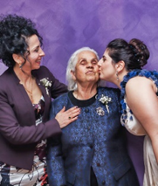
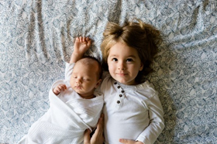


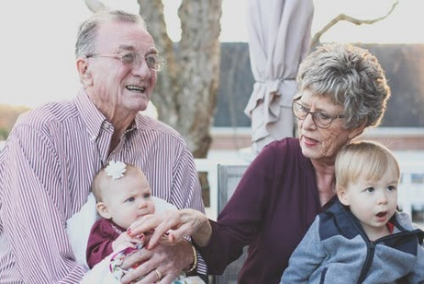

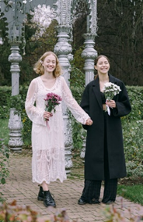
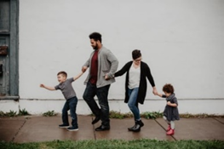

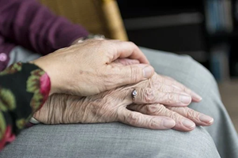
Look at the pictures.
Choose the ones you think best depict a family

Slide 16
Some definitions of a family
The family is a social group characterized by common residence, economic cooperation and reproduction. It includes adults of both sexes, at least two of whom maintain a socially approved sexual relationship, and one or more children, own or adopted, of the sexually cohabiting couple (Murdock, 1949 quoted in Steel, Kidd, & Brown, 2012, p. 2).
A network of related kin (Goldthorpe, 1987 quoted in Steel et al., 2012, p. 3).
A group of persons directly linked by kin connections, adult members of which assume responsibility of caring for children (Giddens 1993 quoted in Steel et al., 2012, p. 2).

Slide 17
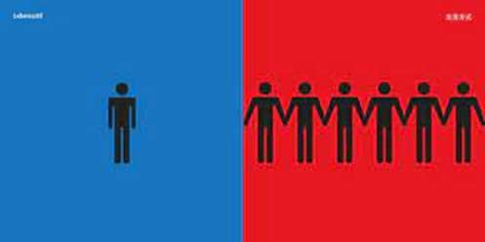
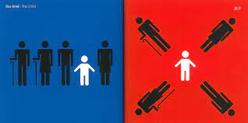
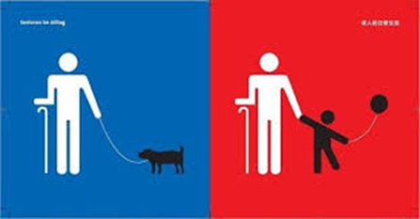
Cultural differences in family concepts
Yang Liu (2010):East meets West
How do you interpret the drawings from your own cultural viewpoint ?

Slide 18
In the picture, two contrasting ways of living are illustrated. On the one hand in many “western” cultures people tend to live a very individualised way. Many people live on their own or in small families. The focus is more on individual happiness than on the happiness of the groups in which people live. For example in many families in the “western” world it is taken for granted that children move to another city once they are grown up to live their own life and focus on their career rather than taking care of their family.
In contrast, there are many other cultures where people tend to live in larger families or communities who are very closely connected and often more dependent on each other.
Hofstede describes the first as “individualism” and the other as “collectivism”: “ What is significant is whether people´s self-image is defined in terms of “I” or “We”. In Individualist societies people are supposed to look after themselves and their direct family only. In Collectivist societies people belong to ‘in groups’ that take care of them in exchange for loyalty.” (www.hofstede-insights.com)
Dagmar Domenig has another expression for this cultural difference. She differentiates between individual-centered and family-centered societies (Domenig p.216).

Slide 19
Family prototypes related to different cultural contexts Heidi Keller (2011)
Prototype: Psychological autonomy | Prototype: Relational attachment
Accepting children how they are | Family relation are in the focus
Perception of children`s needs and wishes | Children take over relevant tasks within the family
Offer possibilities to develop own skills and competences | Children are embedded in a system of expectations and duties
Respect boundaries of the child | Parents are the experts who know what is the best for their children
Praise and appreciation are expressed towards the child
Equal rights model: questions are asked and opportunities are offered

Slide 20
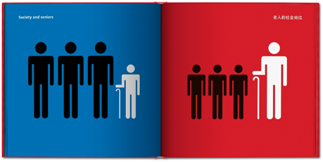
Older people in families
Source: Yang Liu (2010):East meets West

Slide 21
Older people in families
In the two pictures Yang Liu illustrates different kinds of intergenerational relations which might be related to different cultural backgrounds. Older people might play a “bigger” role in some cultures.
This is also expressed in the picture of everyday-life. Depending on the cultural background, older people can play an active role within the family e.g. taking care of the grandchildren whereas in other contexts older family members are less engaged in this role.
When working with clients/patients from different cultural backgrounds we may need to consider that older family members might have more or less influence on the client/patient depending on the cultural background of the family. Grandparents might be a valuable source of support for a family or might interfere in an undesirable way. Furthermore, if we work with older clients/patients we need to be aware of the role they play in their family. Are they well embedded and involved with their families or more isolated from them?

Slide 22
Violence within families across cultures
Unfortunately violence within families or against children occurs across all cultures
However, it may be that violence is justified by the cultural context such as forced marriage or genital mutilation
No matter where it appears violence is always a sign of helplessness and a means to exercise power. And this should not be tolerated
As a social or health care professional you might deal with clients or patients that have experienced different forms of violence.
Find a first aid manual here: First Aid Manual of Emprove Foundation: https://emproveproject.eu/first-aid-kit/

Slide 23
Summary
Families can take different shapes and there might be different concepts of relationships within a family.
In most cases they have a significant impact on the client/patient’s well-being.
Family relations can be a valuable resource for a patient/client
Though sometimes unfavourable constellations within families can have a negative impact on a patient/client
Try to evaluate what the family means to your patient/client. What factors contribute to his or her wellbeing, or are hindering it.
Try to encourage him/her to find the right balance between the sense of belonging to the family and the autonomy of the individual
But be careful not to evaluate this according to our own cultural background!

Slide 24
Childhood across Cultures

Slide 25


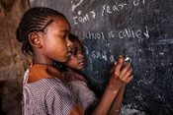
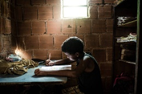
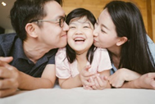
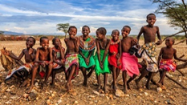
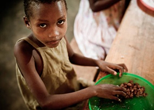



Slide 26
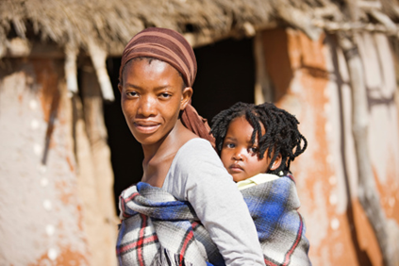
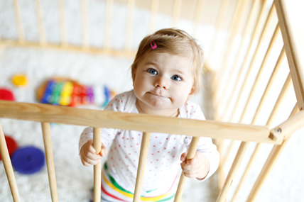
Socialisation strategies in Germany and Cameroon
(Heidi Keller 2011)

Slide 27
Different educational goals of German middle-class families in comparison with Nso women from Cameroon (Keller 2011)
Educational goal for children under the age of three | Level of agreement rated by mothers from Osnabrück | Level of agreement by Nso mothers
Respecting older people | Rather disagree | Strongly agree
Do what elderly people say | Strongly disagree | Strongly agree
Keep social harmony | Slightly agree | Strongly agree
To assert oneself | Slightly disagree | Strongly disagree
To be different from others | Slightly disagree | Strongly disagree
To express the own ideas clearly | Strongly agree | Rather disagree
To develop talents and interests | Strongly agree | Slightly disagree

Slide 28
German mothers i.e. western mothers, placed a great deal of importance on their children developing talents and interests in the first three years of life and learning to assert themselves. They did not attach importance to children of this age doing what their parents tell them and respecting older people.
However, the Cameroonian Nso placed a lot of importance on this, as well as on the other two attachment-oriented goals (sharing with others and maintaining social harmony). They rejected the autonomy-oriented goals in the list. The profile of the two groups show clear differences in the orientation towards autonomy and attachment.
Keller concludes from her research that Western educational approaches are often focussed on an I-perspective instead of focussing on the We-perspective. In her view professionals who deal with the development of children should be aware of the different approaches and perspectives of a child’s needs.

Slide 29
How to deal with / avoid cultural conflicts
Cultural conflicts might arise if goals set by the family differ from those set by other agents of socialisation (school, therapist, etc). This can put additional stress on the child instead of contributing to their wellbeing
If these differences are not taken into account by all the relevant support systems for the child (e.g. the family, the school, the doctor or therapist etc) and relations between them do not function well as a result, the child will be at a disadvantage.
But be careful not generalise with a “culturally pessimistic” view in cases like this. As well as being aware of the potential conflicts that can arise from the different goals we can also ask what can be gained from an increased understanding of these differences.

Slide 30
Empowerment of children who have to deal with contradictions – Helpful sentences
I am able and ready to define my own ideas
I am able and ready to find words for my own goals and values
I can use my own initiative and take responsibility for my own actions
I am able to express my feelings and not take them out on others

Slide 31
Tips for working with bilingual & multilingual families
When we want to encourage families to learn the local language we will not succeed with prohibitions
The opportunity for clients/patients to speak in their first language creates affiliation and trust, especially when dealing with younger children
Try to get involved in a conversation with the children, children are often very creative when dealing with communication barriers
If you feel that talking in a foreign language is problematic in a specific situation, try to say something like: “Petra is here with us but she did not understand what you just said” instead of “nobody understands what you are saying if you are talking in Turkish”. Generalisations like “nobody” normally increase feelings of insecurity and of being stereotyped, which negatively impacts the level of understanding and does not bring any added value to the conversation.
Switching between different languages is normal when growing up bilingually, and should be seen as a sign of creativity and not as a weakness
Use positive rather than negative comments e.g. instead of “I can’t understand you” say “I wish I could understand Turkish!”

Slide 32
Welcoming culture – Representation matters
How to support inclusion when working with diverse families

Slide 33
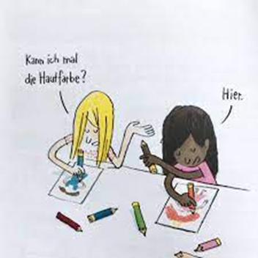
May I have the skin colour pencil? – Here you are!
Source: Labor Arteliergemeinschaft (2017):
Ich so Du so

Slide 34

Self-reflection activity
Describe a “hero” or a “heroine” that you admired as a child:
Which skin colour did your hero(ine) have?
Which ethnic background did they belong to?
Which gender were they?
What were their physical features?

Slide 35
Who to identify with as a child?
We tend to identify with people that are similar to ourselves. Though children who do not have characteristics of the majority in society often do not find identifying figures that have similarities with themselves. The princesses in books are mostly blonde haired with a light skin, for example.
In order to ensure an atmosphere where families can feel welcomed and respected with all their individual characteristics, it is important to create environments where these characteristics are represented.
Playing material and books often represent the societal norm of the majority. To create an environment that allows all families to develop a sense of belonging, social and health care professionals need to critically examine whether and in what form the children and their reference groups are represented in the institution.

Slide 36
Diversity - Checklist
Are there professionals in your institution with a different first language or different ethnic backgrounds?
Are there different languages represented in your institution or in the materials produced by your institution (especially the languages of your target group)?
Are there books/dolls/pictures that depict socially relevant roles (doctors, pilots, etc.) including people from different ethnic backgrounds?
Are there dolls and play figures with different skin colours?
Are there stories in which the main characters wear head coverings?
Are there books/pictures in which different types of family are portrayed?
Do you reflect on your own cultural norms and the impact these can have on our assumptions and perceptions of behaviour e.g. eating and sleeping arrangements
Do rooms reflect the diversity of the families you work with (e.g. pictures of diverse families, signboards in different languages)?

Slide 37
Summary
All families are different even within the same culture
When working with families with different cultural backgrounds to your own you need to have an open mind.
To provide culturally sensitive services you have to listen and
respect other people’s views which may differ from your own.

Slide 38
Reflections and Action Plan
What I have learnt about myself and my own cultural background?
What I have learnt about working with families from diverse cultural backgrounds?
What else would I like to know?
What changes will I make in my current practise to ensure that all cultural considerations are in place for the people for whom I care?

Slide 39


