Slide 1
Culture, Diversity & Raising awareness
Module 1:
Trainer’s Presentation

Slide 2
Learning objectives By the end of this module you will:
Have thought about your own cultural background and how this might influence you.
Have explored definitions of culture.
Have discussed and recognised cultural similarities and differences.
Understand the difference between generalisations and stereotypes.
Understand how to work effectively with people across different cultures.

Slide 3
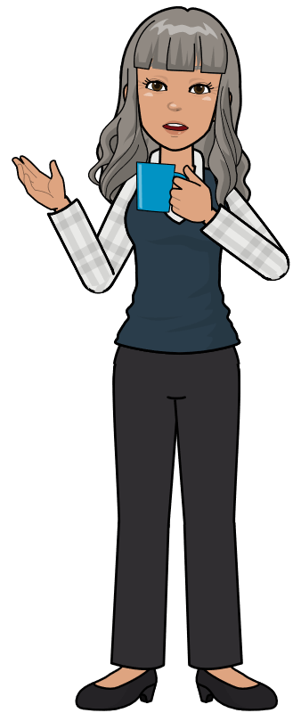
Introduction
Yesterday I was talking to my colleague about her mother-in-law coming to live with her and her husband. She told me that it will be a bit crowded, and the children will have to share a bedroom. I asked her if this was going to be temporary or permanent arrangement. She looked surprised by my questions, and said, of course, it will be a permanent arrangement. I began to wonder about why she said ‘of course’. Why do you think she said that?

Slide 4

Thinking about you. Who are you culturally speaking?
We are born into a culture not with a culture.
Where were you born?
Where were your mother and father born?
Where were your grandparents born?
What culture were you born into?
What is the culture you most align yourself to?

Slide 5
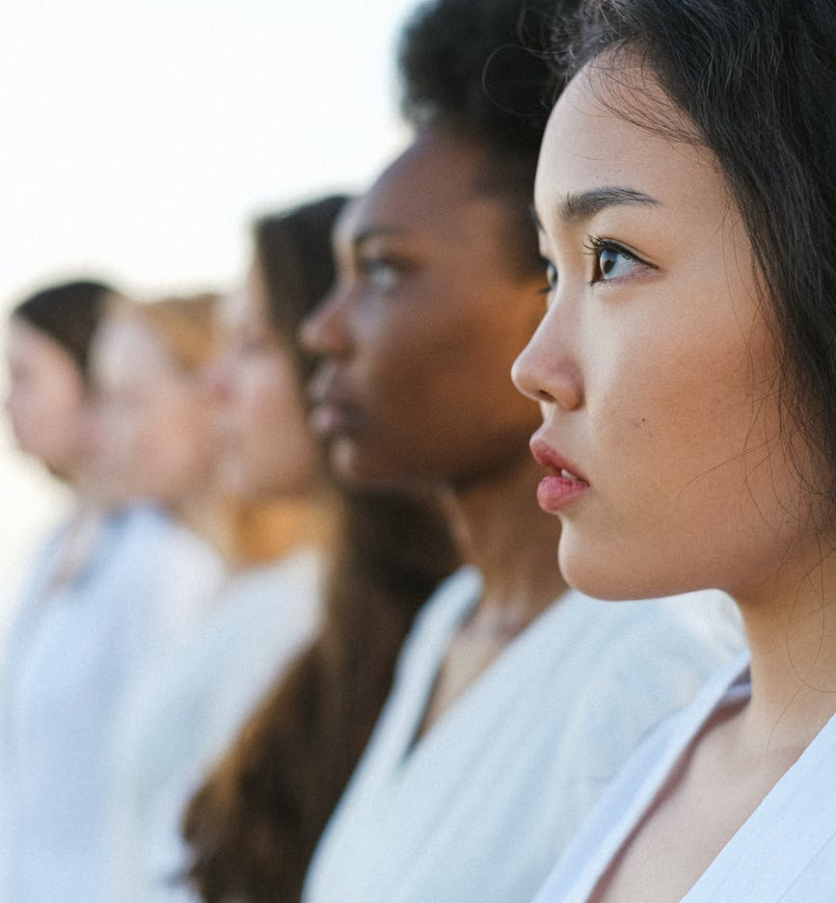
Definitions of culture
There are many different definitions of culture. Below are 4 of them.
Culture is a shared way of living. (Berry)
Culture is the learned and shared values, beliefs and behaviours of a group of interacting people. (Bennett M. )
Culture is a collective programming of the mind. (Hofstede)
Culture is the whole range of human activities which are learnt and not instinctive and which are transmitted from generation to generation through various learning process. ( J. Beattie)
https://www.pexels.com/search/free/

Slide 6

Describing culture
Having read the definitions which one do you think is the best way to describe culture?
Is it?
A
B
C
D
Why do you think this one is the best description?

Slide 7

Cultural contact lenses
A very simple way to think about different cultures is to think of each culture as having a different set of coloured contact lenses, some colours are more similar and others a greater contrast.
At birth a baby is given the contact lenses of his or her culture through which they start and continue to view the world.

Slide 8



Iceberg theory of culture Edward T. Hall A model for thinking about culture
Music, art, architecture, food, drink,
dress, language
Above the water line
Visible cultural practises
Values and thought patterns.
Attitudes to family and group orientations.
Attitudes to time. How we communicate. How we use space.
Hidden ways of culture
Below the water line

Slide 9

Looking at culture
Think about your own cultural background.
Choose an example for the following, all of which are above the waterline.
DRESS – what do people generally wear to go to a wedding?
ARCHITECTURE – what is the most common style of buildings?
FOOD – what food do people eat on a daily basis?

Slide 10
Culture below the waterline
The things in a culture that are below the waterline are the things that we do not easily see or can identify or, in some cases, understand. These are the values and beliefs that are part of a culture that could be termed as ‘the way we do things’.
One example is our attitudes to family. What our attitudes to our family are will often depend whether we belong to a culture that sees people not as individuals but as part of a family group, needing the support of, and providing support to, the family. The needs, wants and wishes of the family are bigger than those of the individual.
In some cultures individuals within the family are taught to be independent from the family and make their own way in the world. The needs, wants and wishes of the individual are bigger than those of the family group.

Slide 11
3 levels of uniqueness in human mental programming adapted from Hofstede 1994 An overview of us all
Personality
Culture
Human Nature
Specific to
individual
Inherited and learned
Specific to group or category
Learned
Inherited
Universal

Slide 12
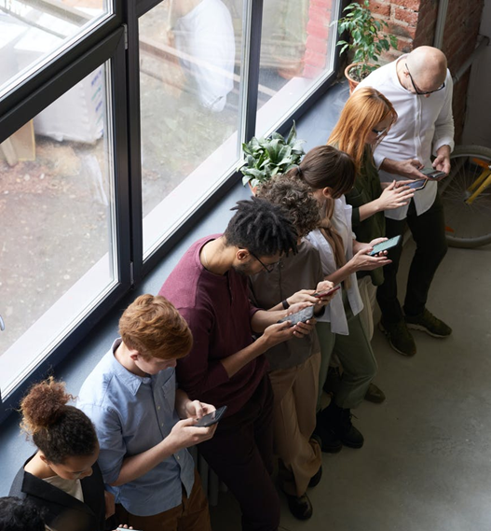
Culture in day to day life
Each person carries around several layers of cultural ‘programming’. It starts when a child learns the basic values of what is right and wrong, good and bad, logical or illogical, and what is thought to be beautiful or ugly.
This learning turns into subconscious judgments that are used daily and also influenced by the individuals personality.
Cultural values are difficult to discuss because they are taken for granted. It is only when a person's assumptions are challenged or they actively think about them and challenge them themselves, that they realise that they exist.
https://www.pexels.com/search/free

Slide 13

Exploring culture and you.
Which statements do you agree with?
I expect to make my own choices about what and where I study / work.
Free will and self determination are very important to me.
I know I should always consult my family on important decisions.
The good of the family unit is more important than me doing exactly what I want to do.
I have always been encouraged to be independent and make my own decisions.
I think always speaking my mind and saying exactly what I mean, is the best thing to do.
I was brought up to not speak my mind but to listen to those older than me.

Slide 14

Cultural rights and wrongs
There are no right or wrong responses to the statements.
Your responses will depend on your own culture and your personality.
It is important that we don’t assume other people are wrong if they have a different set of responses.
Providing a service in any healthcare setting staff need to understand their own cultural values and recognise that those from a cultural background different to theirs may be different.
https://www.pexels.com/search/free/

Slide 15
Summary
There are 2 different layers to culture. The observable things like food, dress and architecture. Then there are the values and the basic assumptions that drive people to think and behave in certain ways.
It can be difficult to discover the values that govern people responses and behaviour in cultures different to our own. However we must strive to find out what these might be.
It can also be difficult for us to identify what our own values and assumptions are, that are driving our behaviour. We should try and be aware of them.
To work effectively across cultures we need to ask questions, listen effectively and suspend our own cultural judgements.
We should also try to identify our unconscious thoughts that drive our responses in situations. Often referred to as unconscious bias.

Slide 16
Diversity & Unconscious Bias

Slide 17
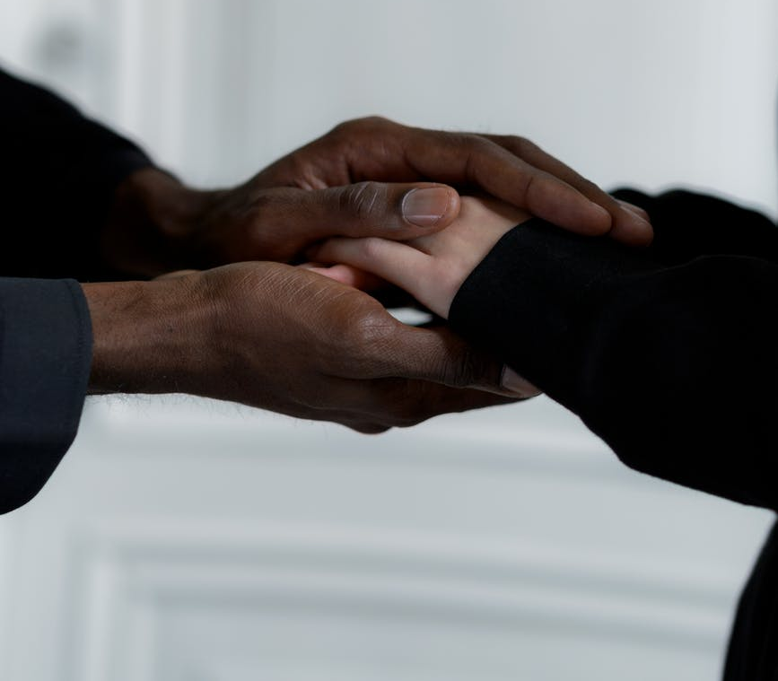
Thinking about different cultural backgrounds
We live in diverse societies, but we can hold subconscious attitudes about those who are from different cultural backgrounds to ourselves.
We can be influenced by stereotypes that can be both negative and positive.
These can influence the way we interact and understand others.
https://www.pexels.com/search/free/

Slide 18
Stereotypes and Generalisations
Stereotypes
Generalisations
…are an ending point. No effort is made to ascertain whether it is appropriate to apply it to the person or group in question.
… serve as a starting point. They can help us make sense of our world by using information we already know.

Slide 19

Stereotypes and Generalisations
Case Study
Alice has a new client called Priti, who is a woman of Asian background. When Alice is discussing with Priti about her care, Priti tells her she comes from a large family. On hearing this Alice assumes that Priti belongs to a large extended family and 3 generations of the family live together in the same house, and she will have plenty of support at home.

Slide 20

Alice and Priti - Questions
a. What assumptions did Alice make about Priti?
b. Do you think Alice was right in her assumptions about Priti?
c. Do you think Alice was using a stereotype to make her assumptions?
d. Do you think the assumptions that Alice made could influence the care package she is discussing with her?

Slide 21
Alice and Priti
Alice was basing her assumptions on a stereotype that all Asian people have large families and that they live in inter- generational households.
This is true of some Asian people but not all.
Because of this it would be fair to use a generalisation. She could have thought, Asian people tend to belong to large family groups, I wonder if Priti does.
Alice could then have taken the time to find out if what she had thought was true or not.
Using stereotypes can make us make unfair and unsound judgments about people and their cultural background which can affect their care.

Slide 22

About you
Has anyone ever made an assumption about you?
What do you think the assumption was based on? Was it a stereotype?
Was it accurate?
Why do you think people make assumptions about others?

Slide 23
Unconscious bias
We make assumptions about people that can be both positive or negative because of our unconscious bias.
Unconscious bias is the brain’s automatic tendency to take mental shortcuts based on stereotypes and preconceptions about what is right and wrong.
It is an adaptive skill that we use subconsciously to quickly process millions of bits of information, but it can cause problems when needing to provide a good service across all cultures.

Slide 24

Systems Thinking
If we had to think long and hard about every decision we had to make during the day we would become exhausted.
So to lighten the load our brain’s decision making is broken down into two systems, one fast thinking and one slow and deliberate.
We need to choose the right type of brain thinking for different situations.
System 1 for everyday situations.
System 2 for more important decisions.
https://www.pexels.com/search/free/

Slide 25
Systems Thinking (Daniel Kahneman)
Simply put our brains have 2 systems which we use when making the 1000’s of decisions that we have to make every day.
System 1 Thinking
FAST
Unconscious, automatic, effortless.
Without self-awareness or control.
Assesses the situation, makes quick decisions.
Makes up 98% of all our thinking.
System 2 Thinking . SLOW
Deliberate and conscious, controlled mental process, rational thinking.
With self-awareness or control.
Seeks new/missing information to make decisions.
Makes up 2% of all our thinking.

Slide 26

Systems Thinking
Which type of thinking, either System 1 or 2, should you use for each of the situations?
How much milk to put in your tea or coffee.
What top or shirt to wear when you are getting dressed.
How to answer questions in an interview for a job.
How to plan a trip away.
What to ask a client about what they need.
What to eat for lunch.
How to identify the factors needed to decide on the best way to care for someone.

Slide 27


Answers
a. 1
b. 1
c. 2
d. 2
e. 2
f. 2
g. 1
h. 2
https://www.pexels.com/search/free/

Slide 28
Summary
We use System 1 Thinking for the everyday decisions. If we had to think long and hard about everything we would find life very difficult. Our brain uses shortcuts and patterns to draw conclusions by using the information subconsciously stored in our mental lockers. This allows us to make swift assessments of situations.
However we often use System 1 Thinking when we should be using System 2 Thinking. This is when we can allow our unconscious bias to influence our decisions and not always make the best ones. This can lead to us making decisions about the care we are giving based on what we know and not finding out what we don’t know.
Developing our competency in becoming culturally aware will help us move into System 2 Thinking in situations where we need to know more to better understand the needs and wants of people from cultures different to our own.

Slide 29
Working Across cultures

Slide 30
Importance of recognising our own and others culture
No culture is superior to another. When we attempt to judge the relative values of a different culture, we will be using our own culture as a yard stick, in making that judgement.
To provide a culturally appropriate service we need to be aware of our own cultural values and expectations, and make time to explore the possible differences in attitudes, values, beliefs and ways of doing things in other cultures.

Slide 31

Case Study
The working day had ended and one staff member was feeling particularly tired that day. She had spent the afternoon dealing with an elderly woman who seemed to be unable to make any decisions on her preference for treatment and care. This was such a contrast to the elderly woman with whom she had been dealing with in the morning. She had been vocal and assertive in what she wanted and how she wanted it. They had discussed together what was possible, negotiated a bit, and now the woman was satisfied and knew what to expect.
Her client in the afternoon didn’t make eye contact with her, replied ‘yes’ to most questions and said she was ‘happy’ with the plans, but needed to speak to her family about it.
Actually she hadn’t looked happy whilst she had been speaking to her, she looked anxious and unhappy. The more she was pressed for a decision, that she was quite capable of making, she repeated, ‘you must ask my family, I am only an old woman’.

Slide 32

Questions
What do you think the issues are in this story?
Do you think that there were any cross-cultural misunderstandings taking place?
What do you think the morning clients values were?
What do you think the afternoon clients values were?
What do you think the staff member could have done to improve the way they handled the situation in the afternoon, to make the client feel happier and comfortable with the discussion?

Slide 33

Cultural values
Choose which statement you most agree with.
I have an unquestioning respect for my elders. OR Respect has to be earned and is not freely given.
Learning from authority is expected. OR Learning from experience is encouraged.
Ambitions are family centred and seen as ways of improving the family. OR Individuals are free to pursue their own ambitions.
Dependence on family is valued. OR Independence is valued.
Family based activities are seen as the norm. OR Spending time with one’s peer group is seen as the norm.

Slide 34
Summary
To improve your inter-cultural competencies, you must know yourself, your opinions, biases, values and understand the influence your own cultural background has on you.
In intercultural encounters, take your time to explore what the other persons way of seeing the world is, don’t assume it is the same as yours.
Don’t assume there is only one way of doing things or one solution to a problem or issue. There may be others you have not thought of from another cultural perspective.
Be mindful that people who are speaking your language as their second language may not use it in the same way as you. They may be translating directly from their own first language.
Make sure you use clear, unambiguous language when you are asking questions and listen to and check out the answers to ensure a joint understanding, in order to provide a quality service.

Slide 35
Working in culturally diverse teams

Slide 36
Benefits of culturally diverse teams
Managing and working in a culturally diverse team can be challenging. Understanding cultural diversity and having a positive outlook of the benefits of cultural diversity results in diverse teams being able to provide a better service to clients and patients.
Understanding cultural differences and recognising ones’ own cultural values and how these can impact on building an effective team is part of developing emotional intelligence (understanding ourselves and others).

Slide 37

Working in a culturally diverse team
List 3 benefits to the team.
List 3 benefits for your patients / clients.

Slide 38
Working well in a culturally diverse team
Acknowledge and respect cultural differences.
Ensure everyone can contribute to the teams ‘norms’ (the ways of doing things).
Encourage sharing when problem solving to use everybody's cultural experience and beliefs.
‘Over’ communicate – that is take longer to ensure everyone understands exactly what the ‘problem’ is and what the ‘outcome’ will be in all situations.
Take time to build rapport and trust in the team.
Leverage cultural diversity – use it as a key resource to enable the team to provide an excellent service.

Slide 39
Summary
Diverse cultural teams can present challenges but used positively lead to developing respect and sensitivity for other cultures.
If healthcare providers implement a framework that makes it easier to understand each other and collaborate it is an asset.
It’s not enough just to learn how to successfully navigate cultural diversity in the workplace it is important to use it to the organisations advantage by embracing differences, new perspectives and different ways of doing things. Having a cross-cultural team presents opportunities for creativity, innovation and learning from others of a different background.

Slide 40

Reflection and Action plan
Identify 3 things you have learnt from this module.
1
2
3
Write down 3 actions you will take/ behaviours you will change, as a result of your learning.
1
2
3

Slide 41


